Slide 1
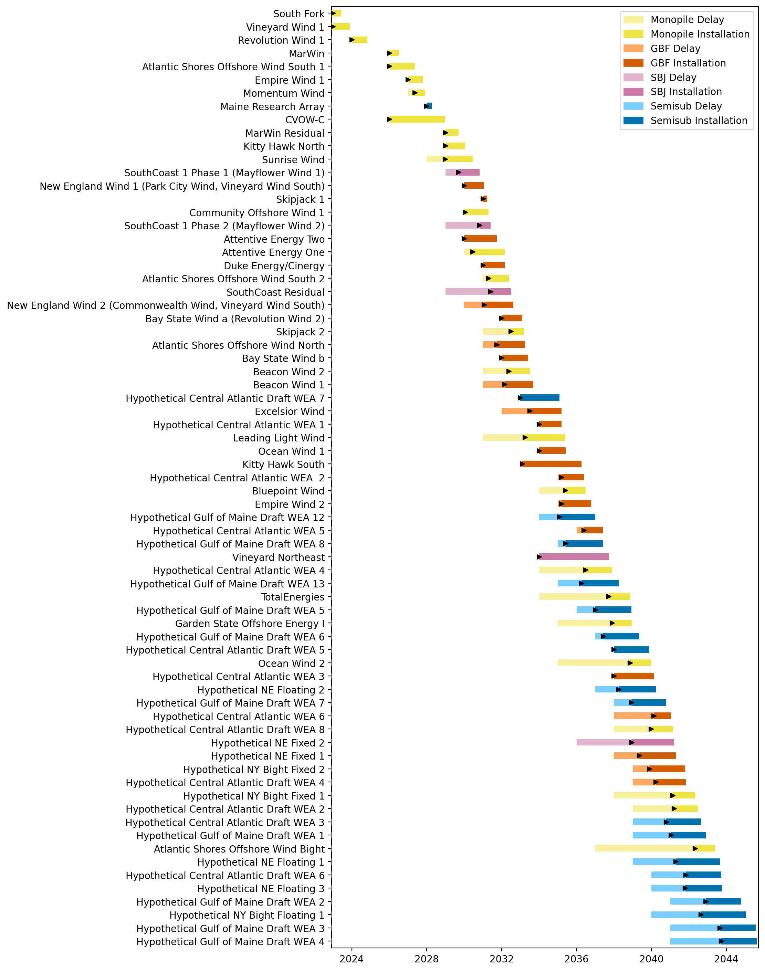
Full Gantt

Slide 2
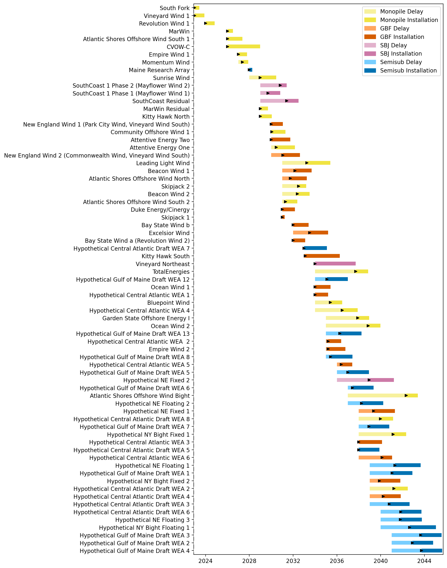
Sorted Full Gantt

Slide 3
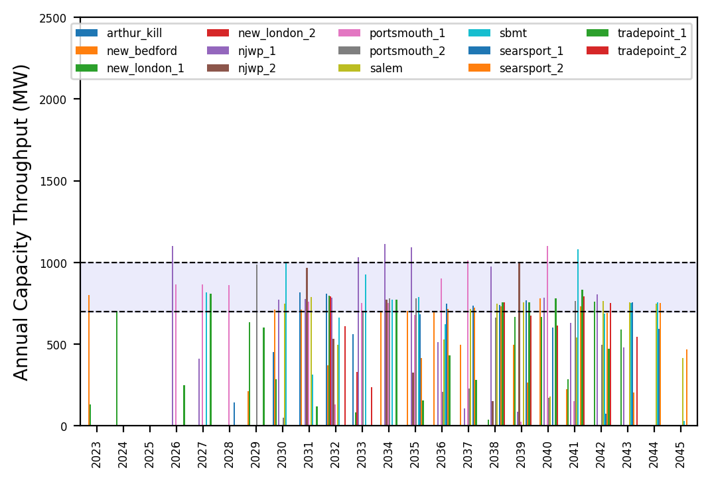
Port Throughput

Slide 4
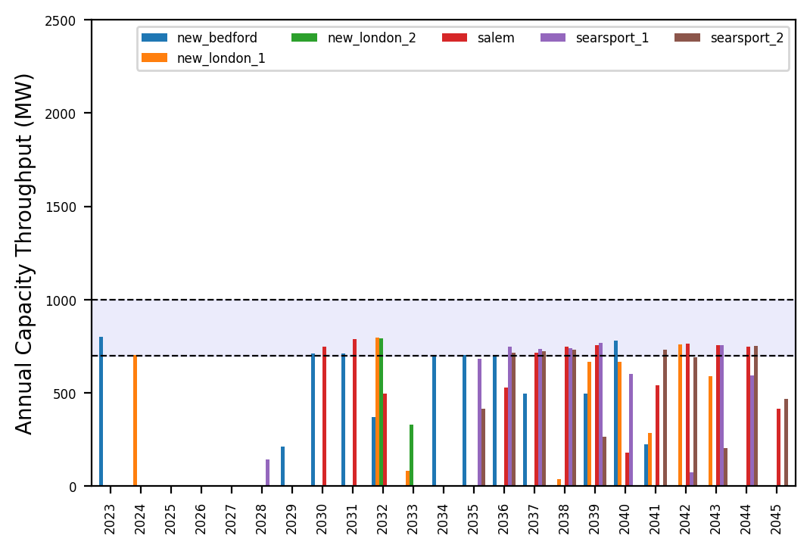
Port Throughput

Slide 5
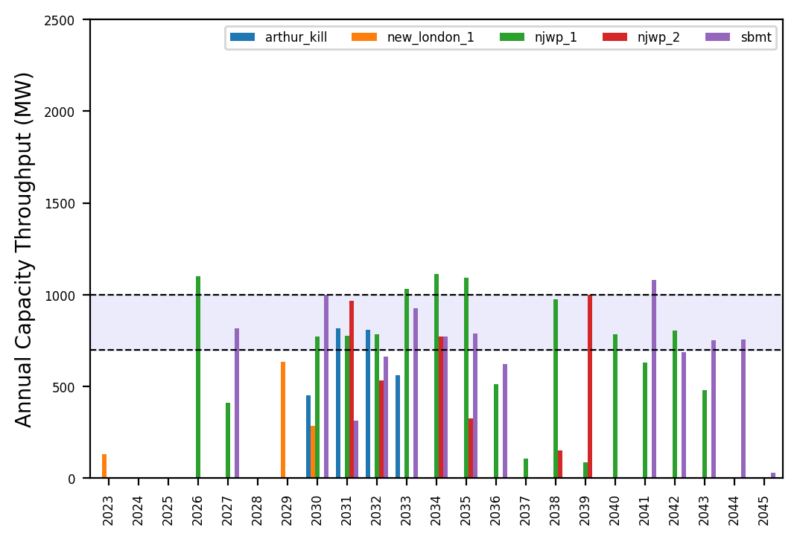
Port Throughput

Slide 6
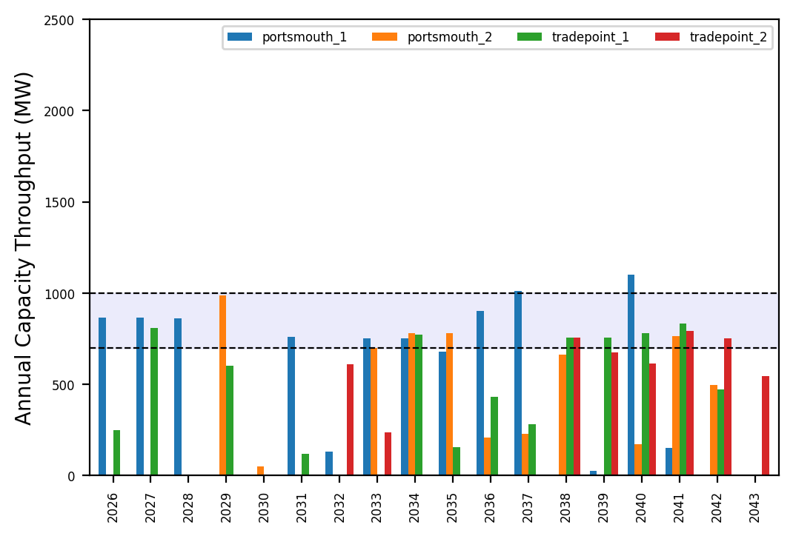
Port Throughput

Slide 7
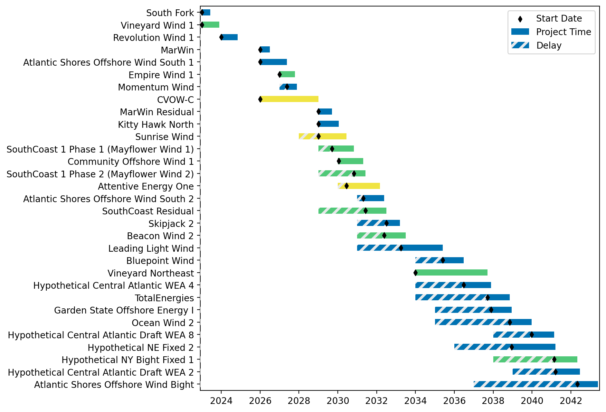
Fixed Gantt

Slide 8
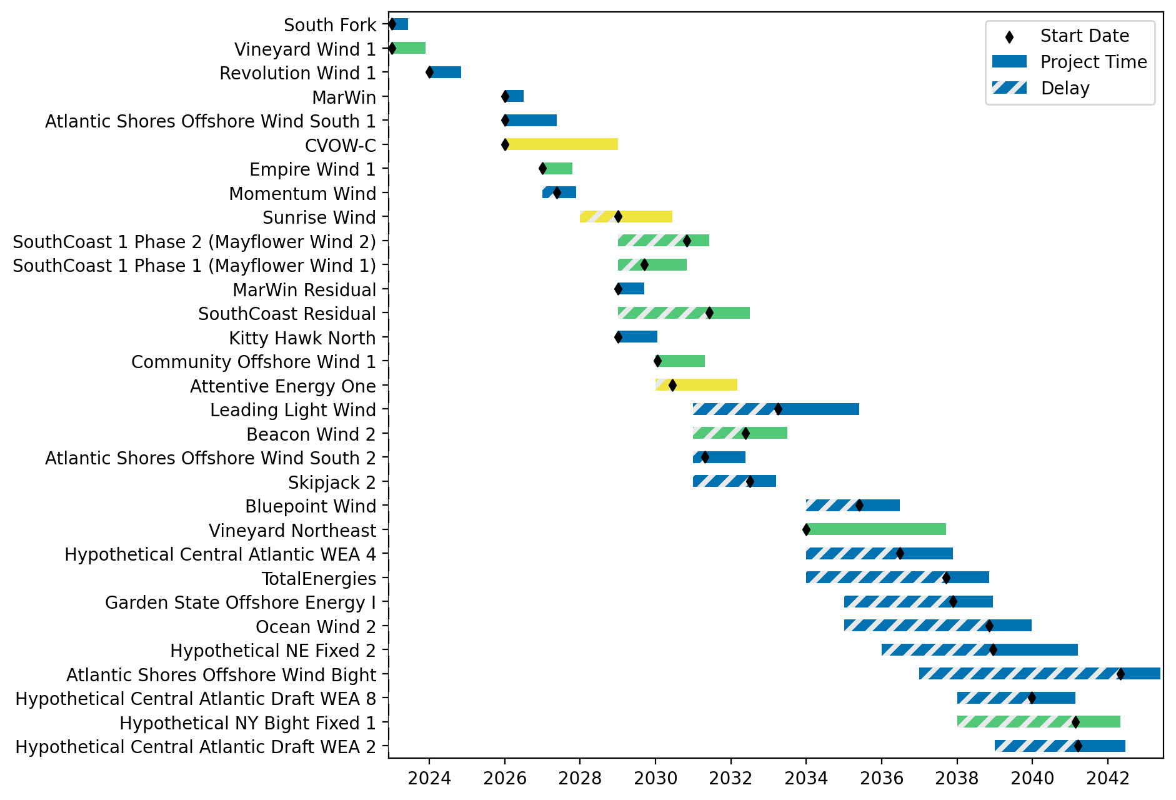
Sorted Fixed Gantt

Slide 9
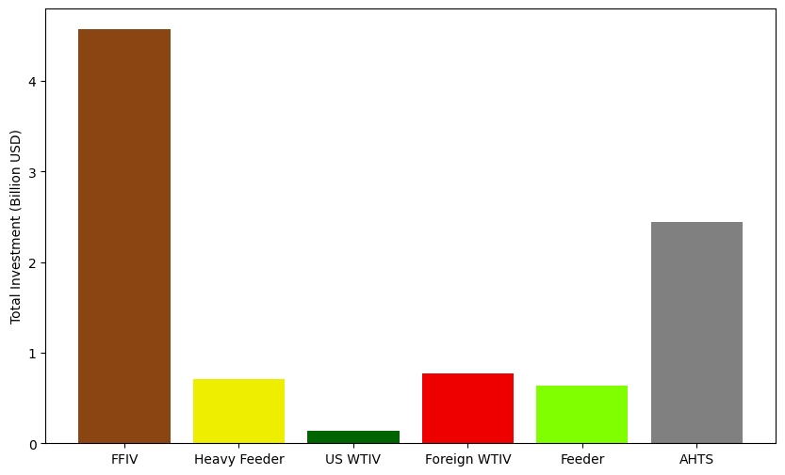
Total Vessel Investments

Slide 10
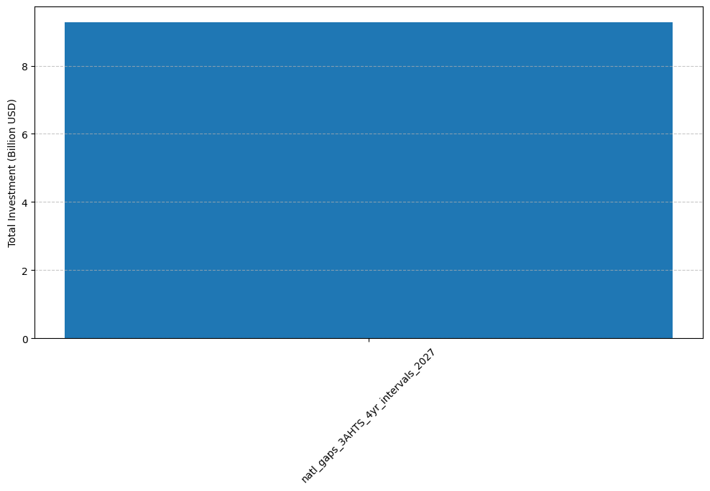
Total Vessel Investments by Scenario

Slide 11
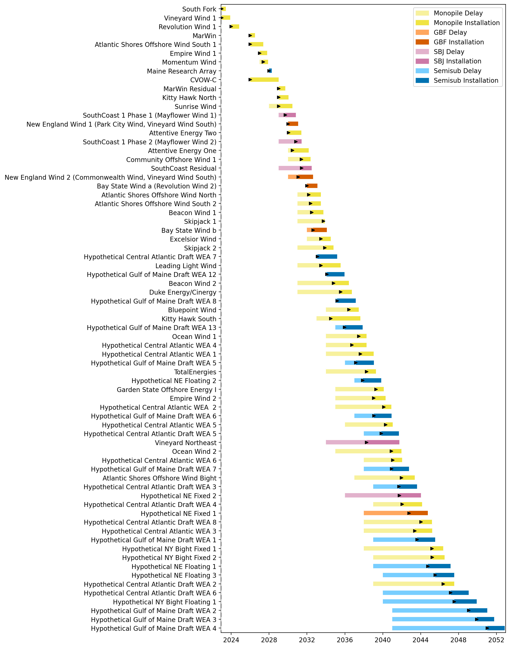
Full Gantt

Slide 12
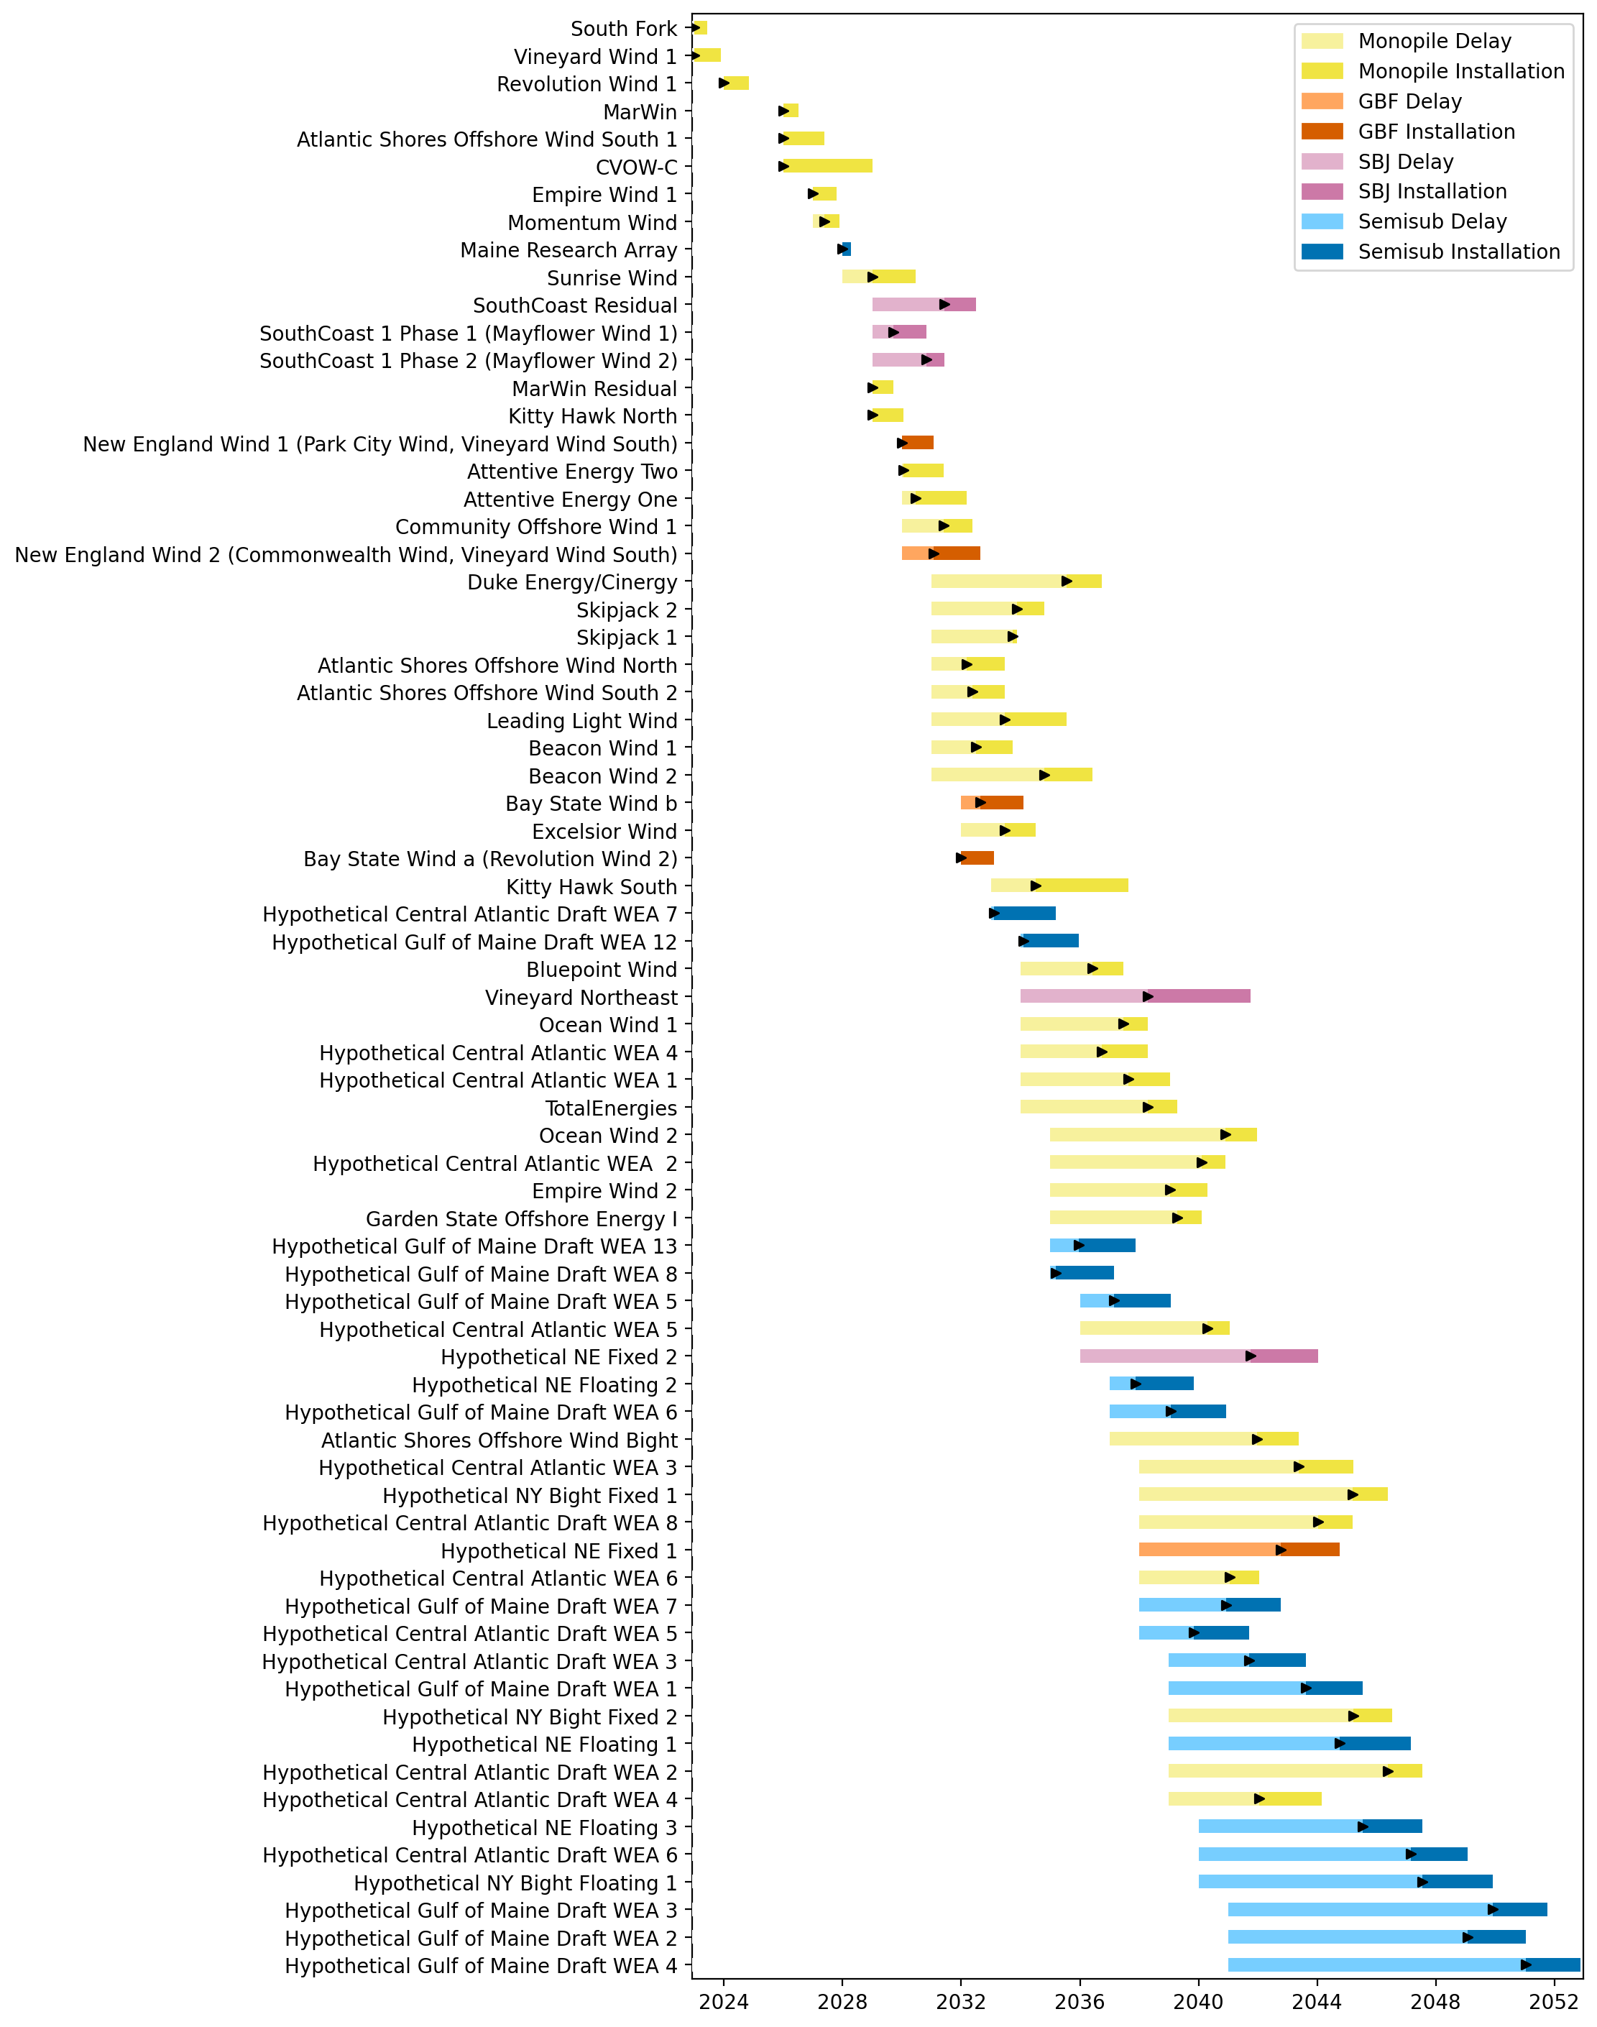
Sorted Full Gantt

Slide 13
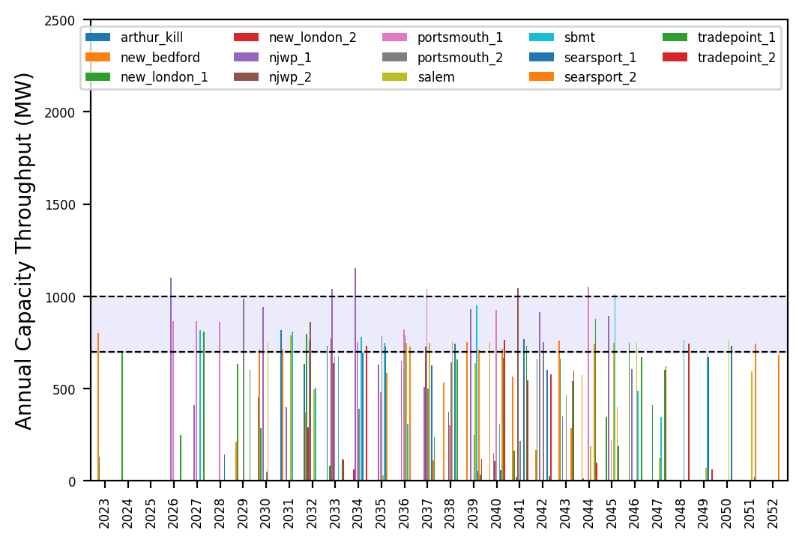
Port Throughput

Slide 14
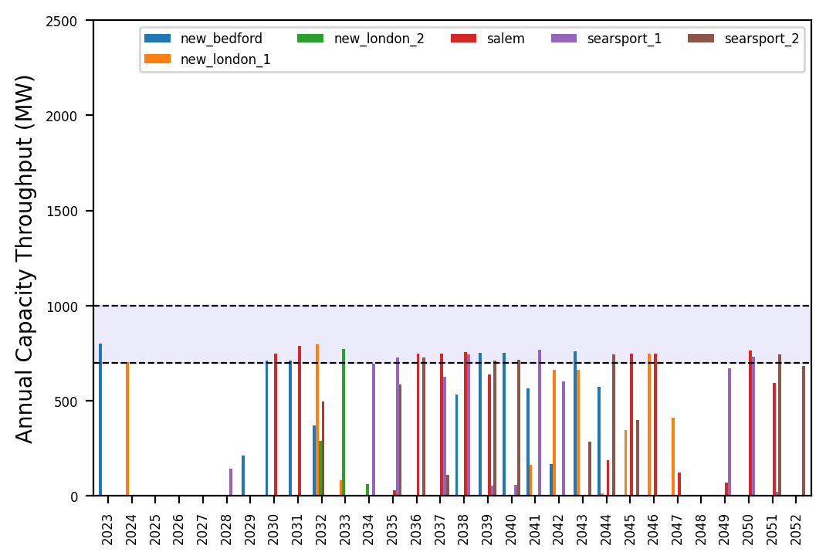
Port Throughput

Slide 15
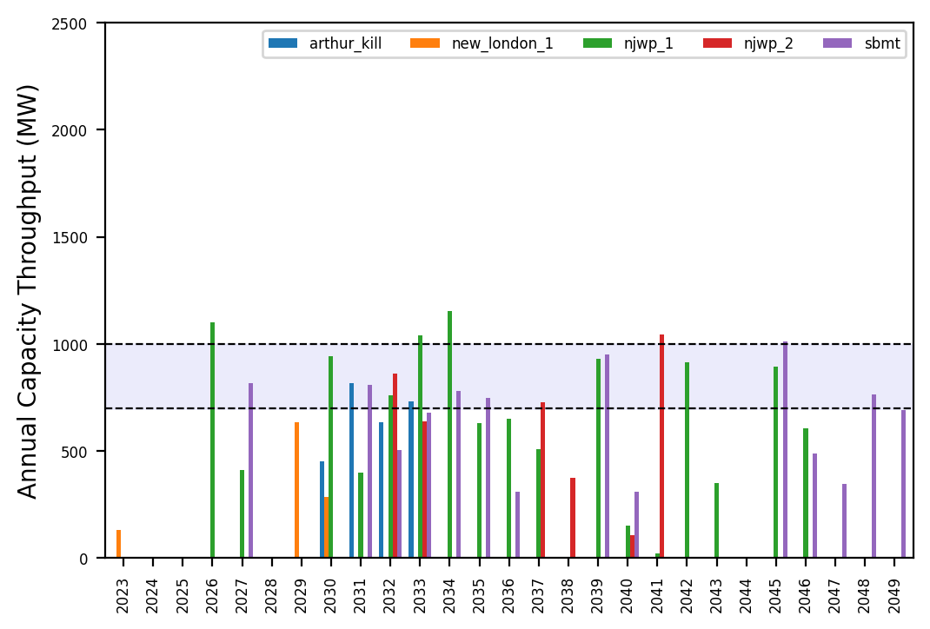
Port Throughput

Slide 16
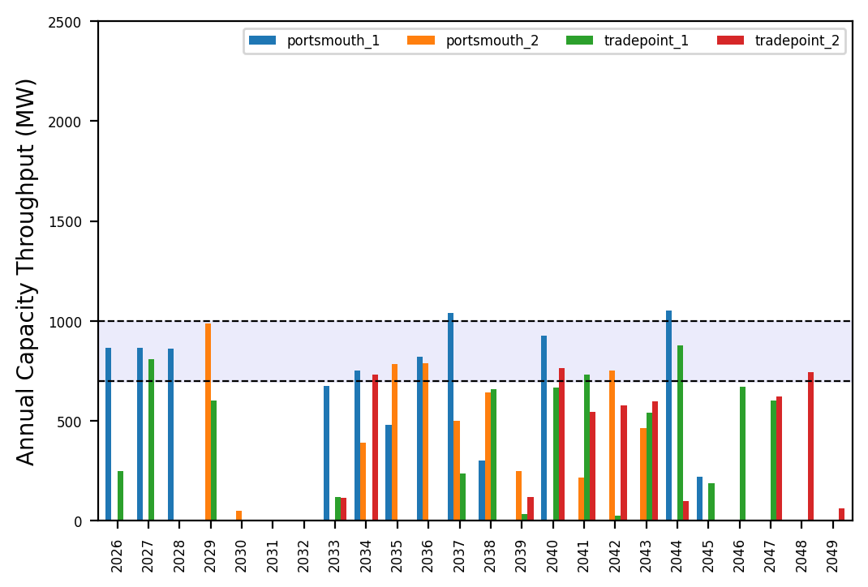
Port Throughput

Slide 17
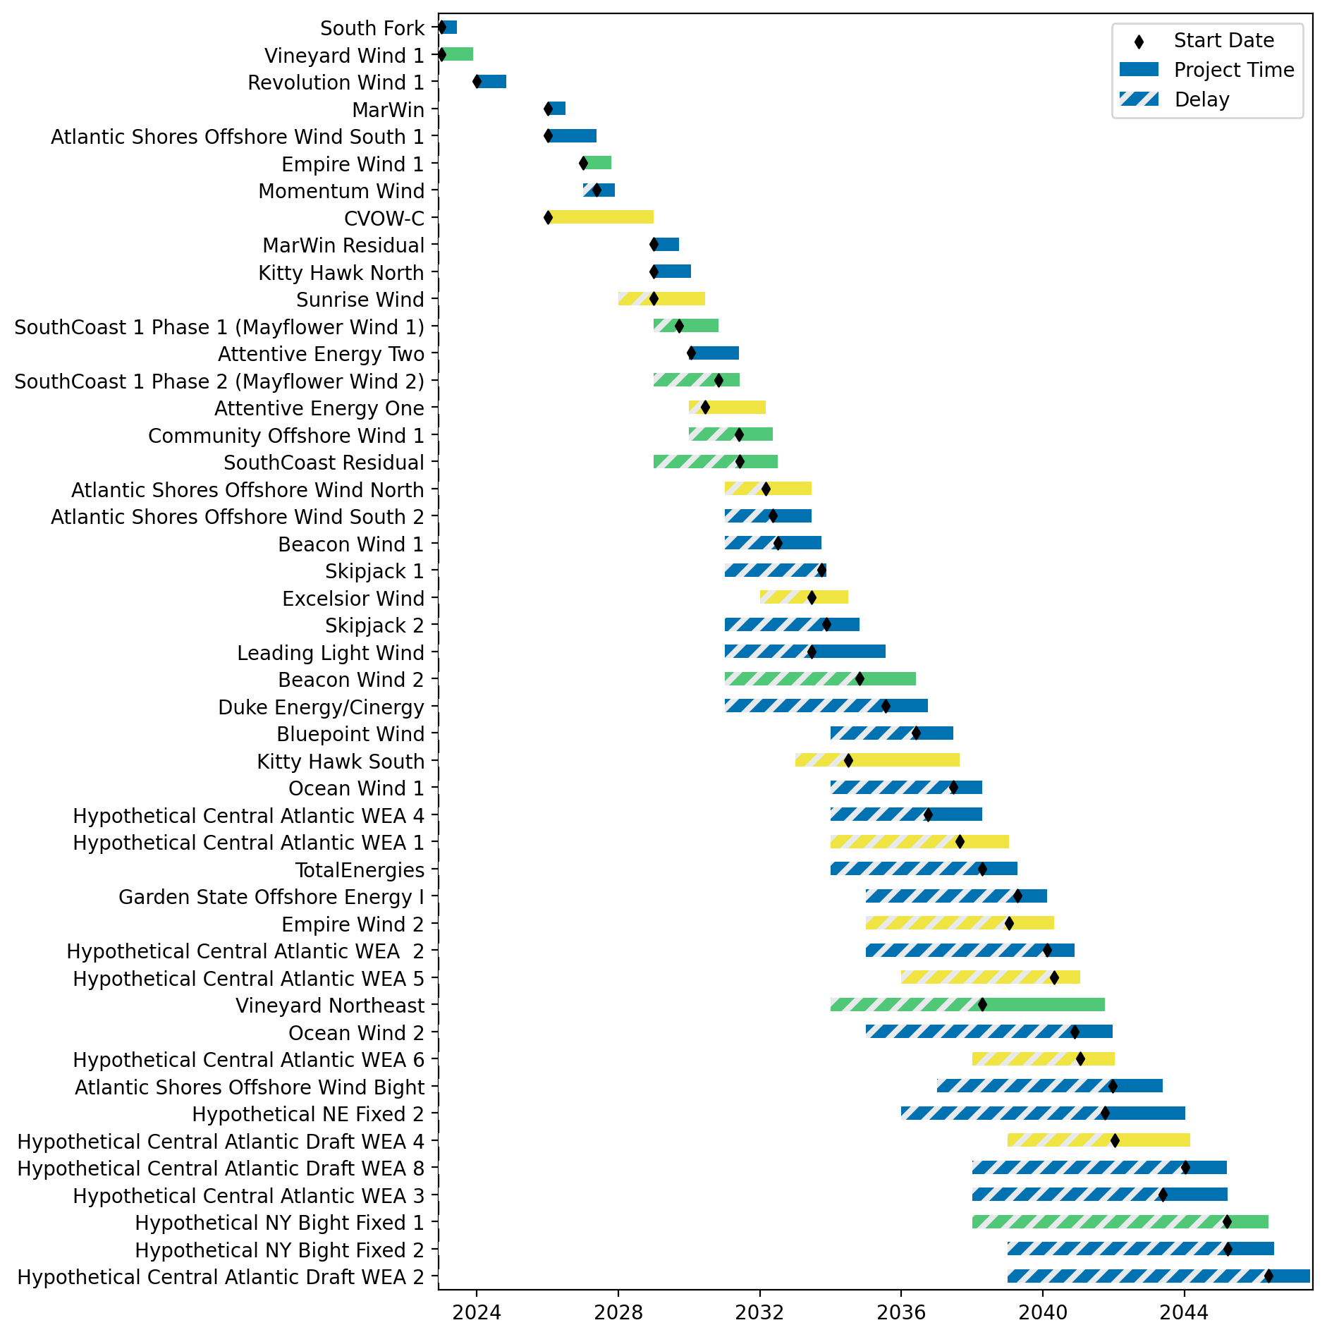
Fixed Gantt

Slide 18
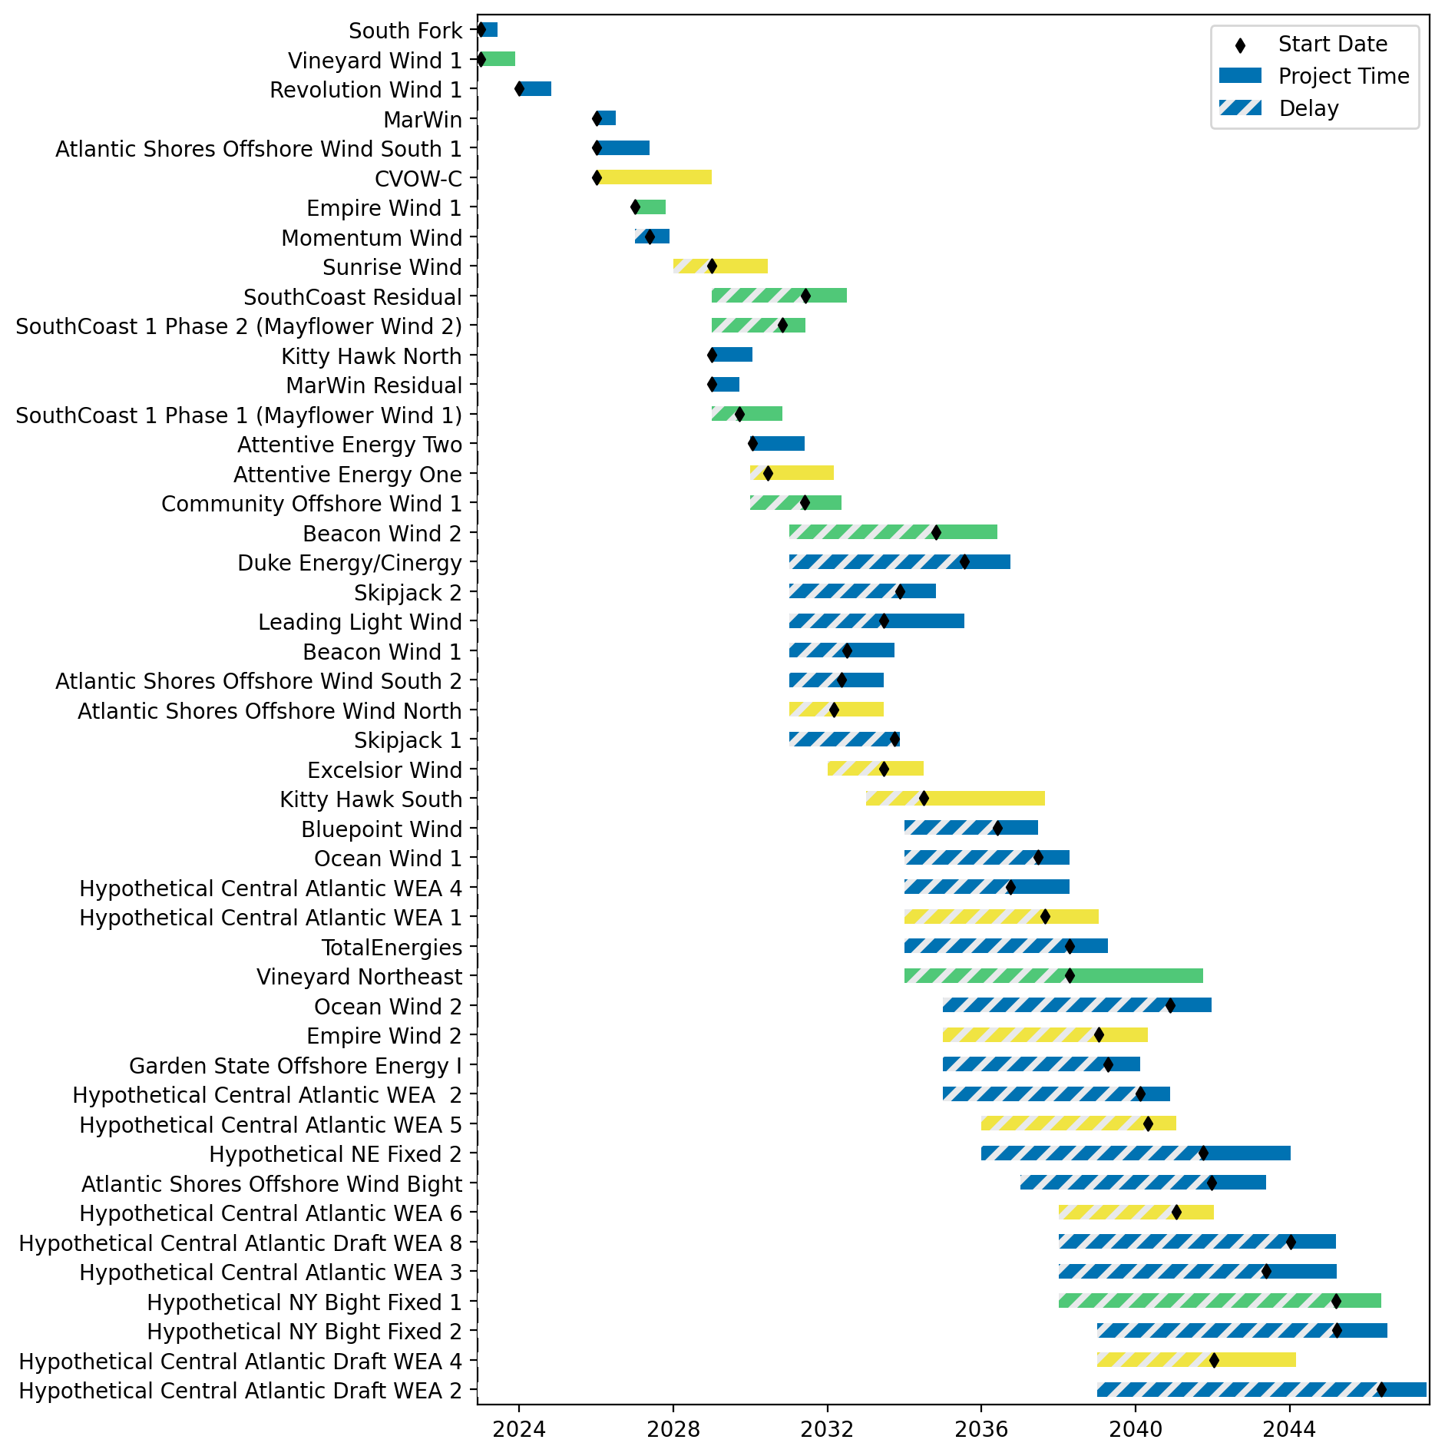
Sorted Fixed Gantt

Slide 19
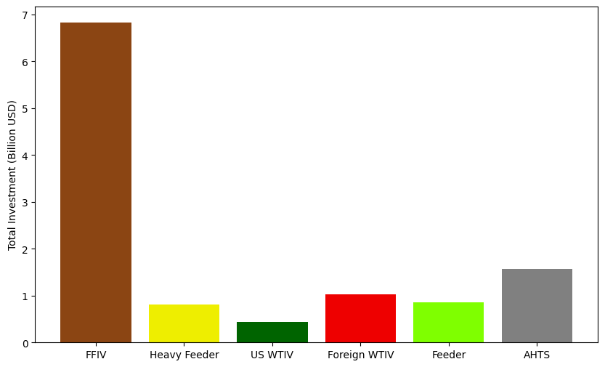
Total Vessel Investments

Slide 20
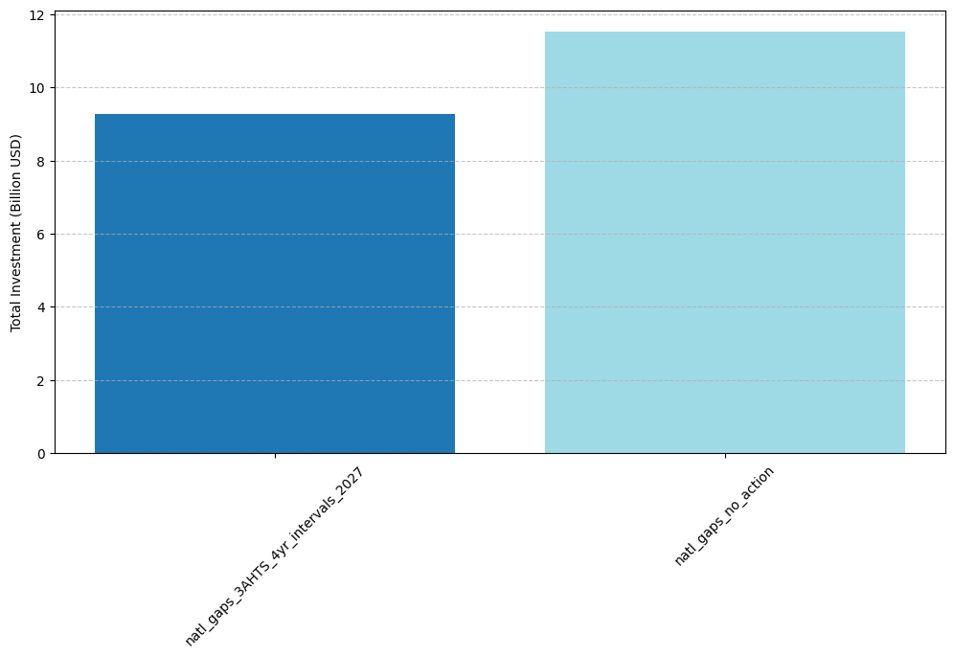
Total Vessel Investments by Scenario

Slide 21
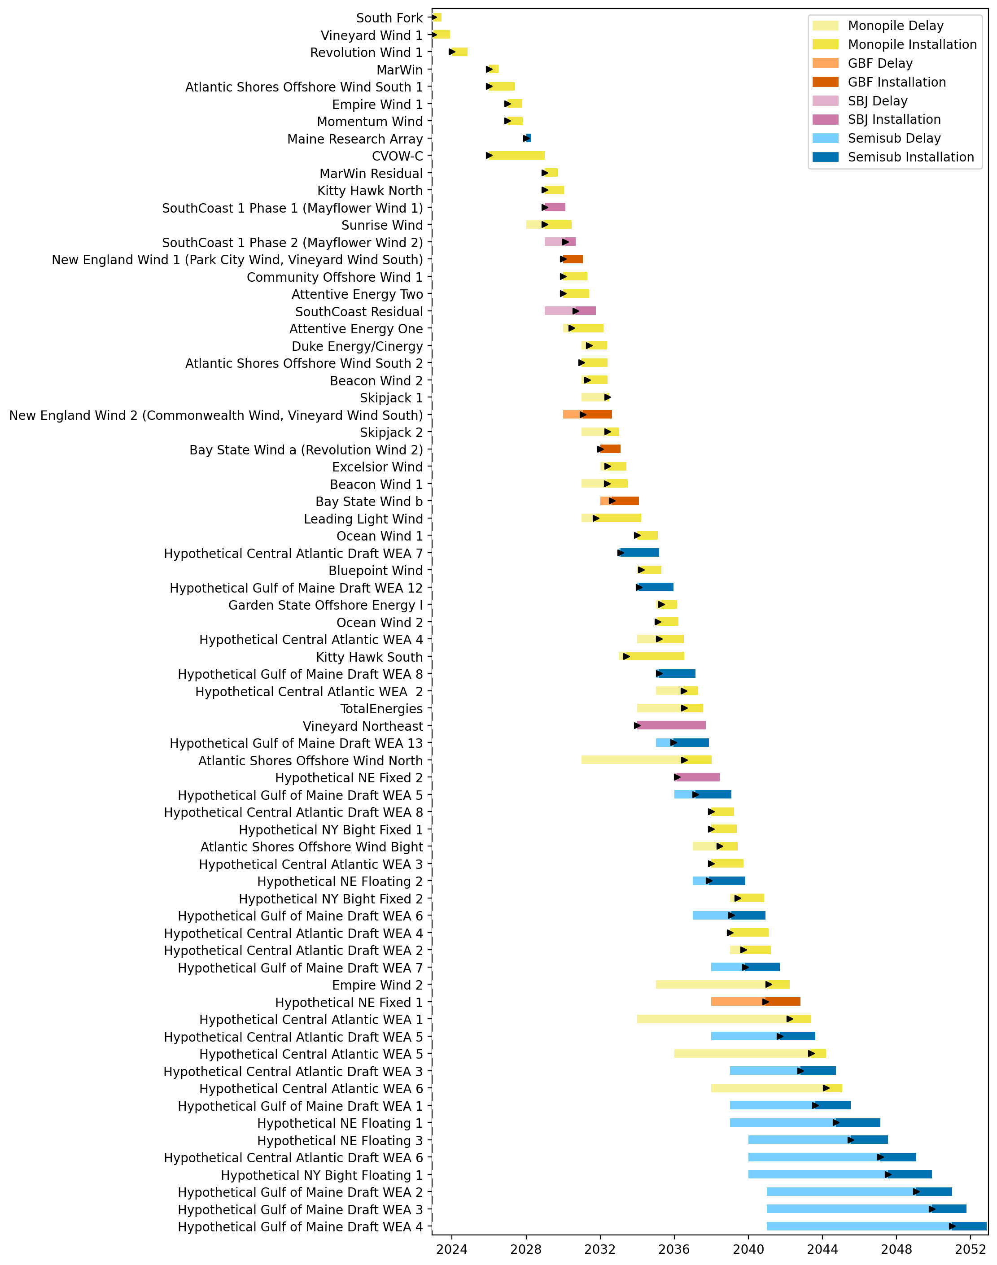
Full Gantt

Slide 22
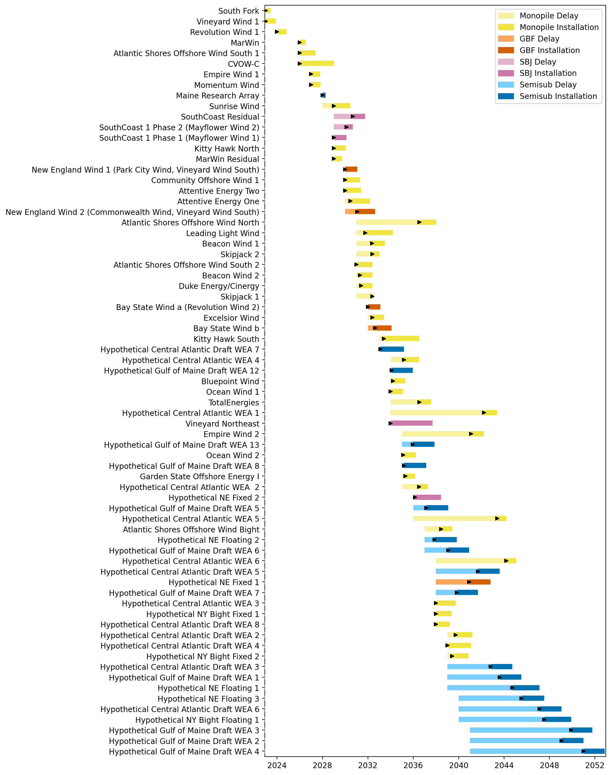
Sorted Full Gantt

Slide 23
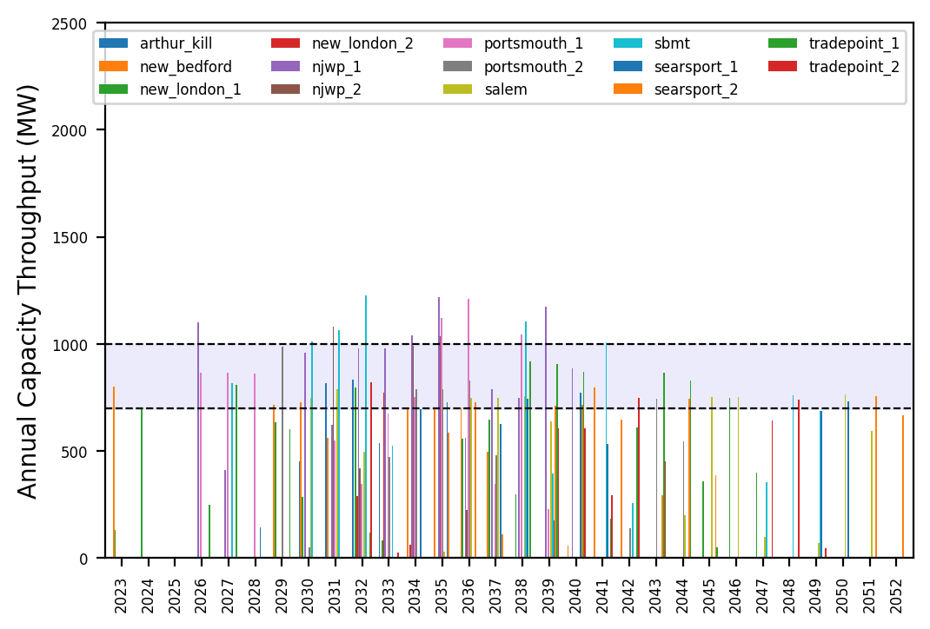
Port Throughput

Slide 24
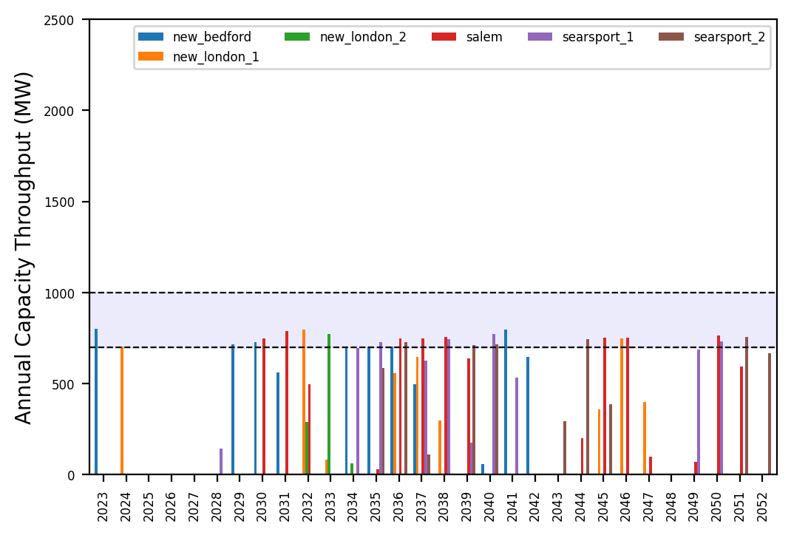
Port Throughput

Slide 25
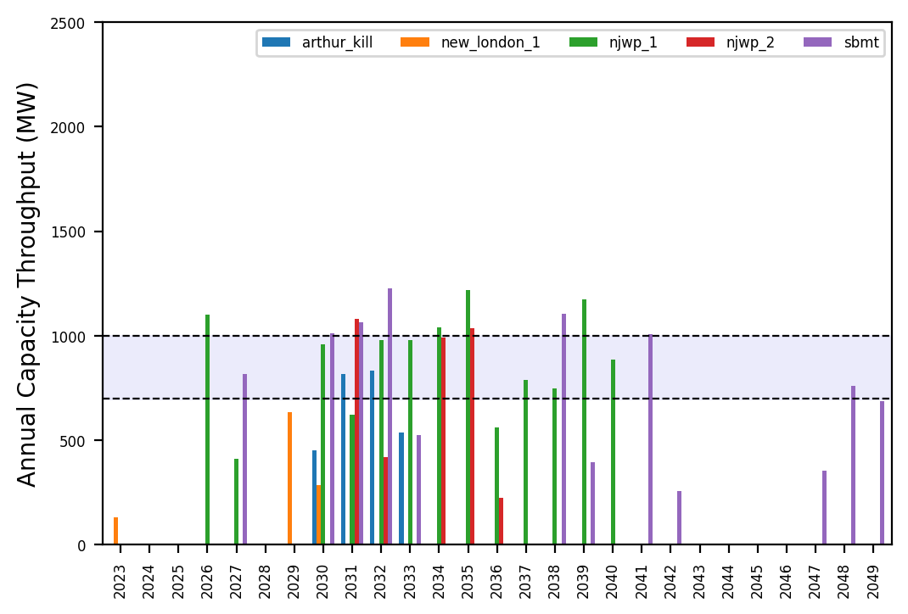
Port Throughput

Slide 26
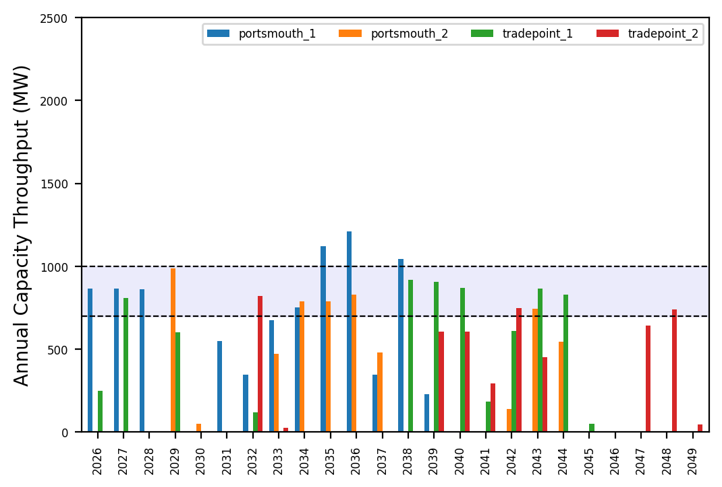
Port Throughput

Slide 27
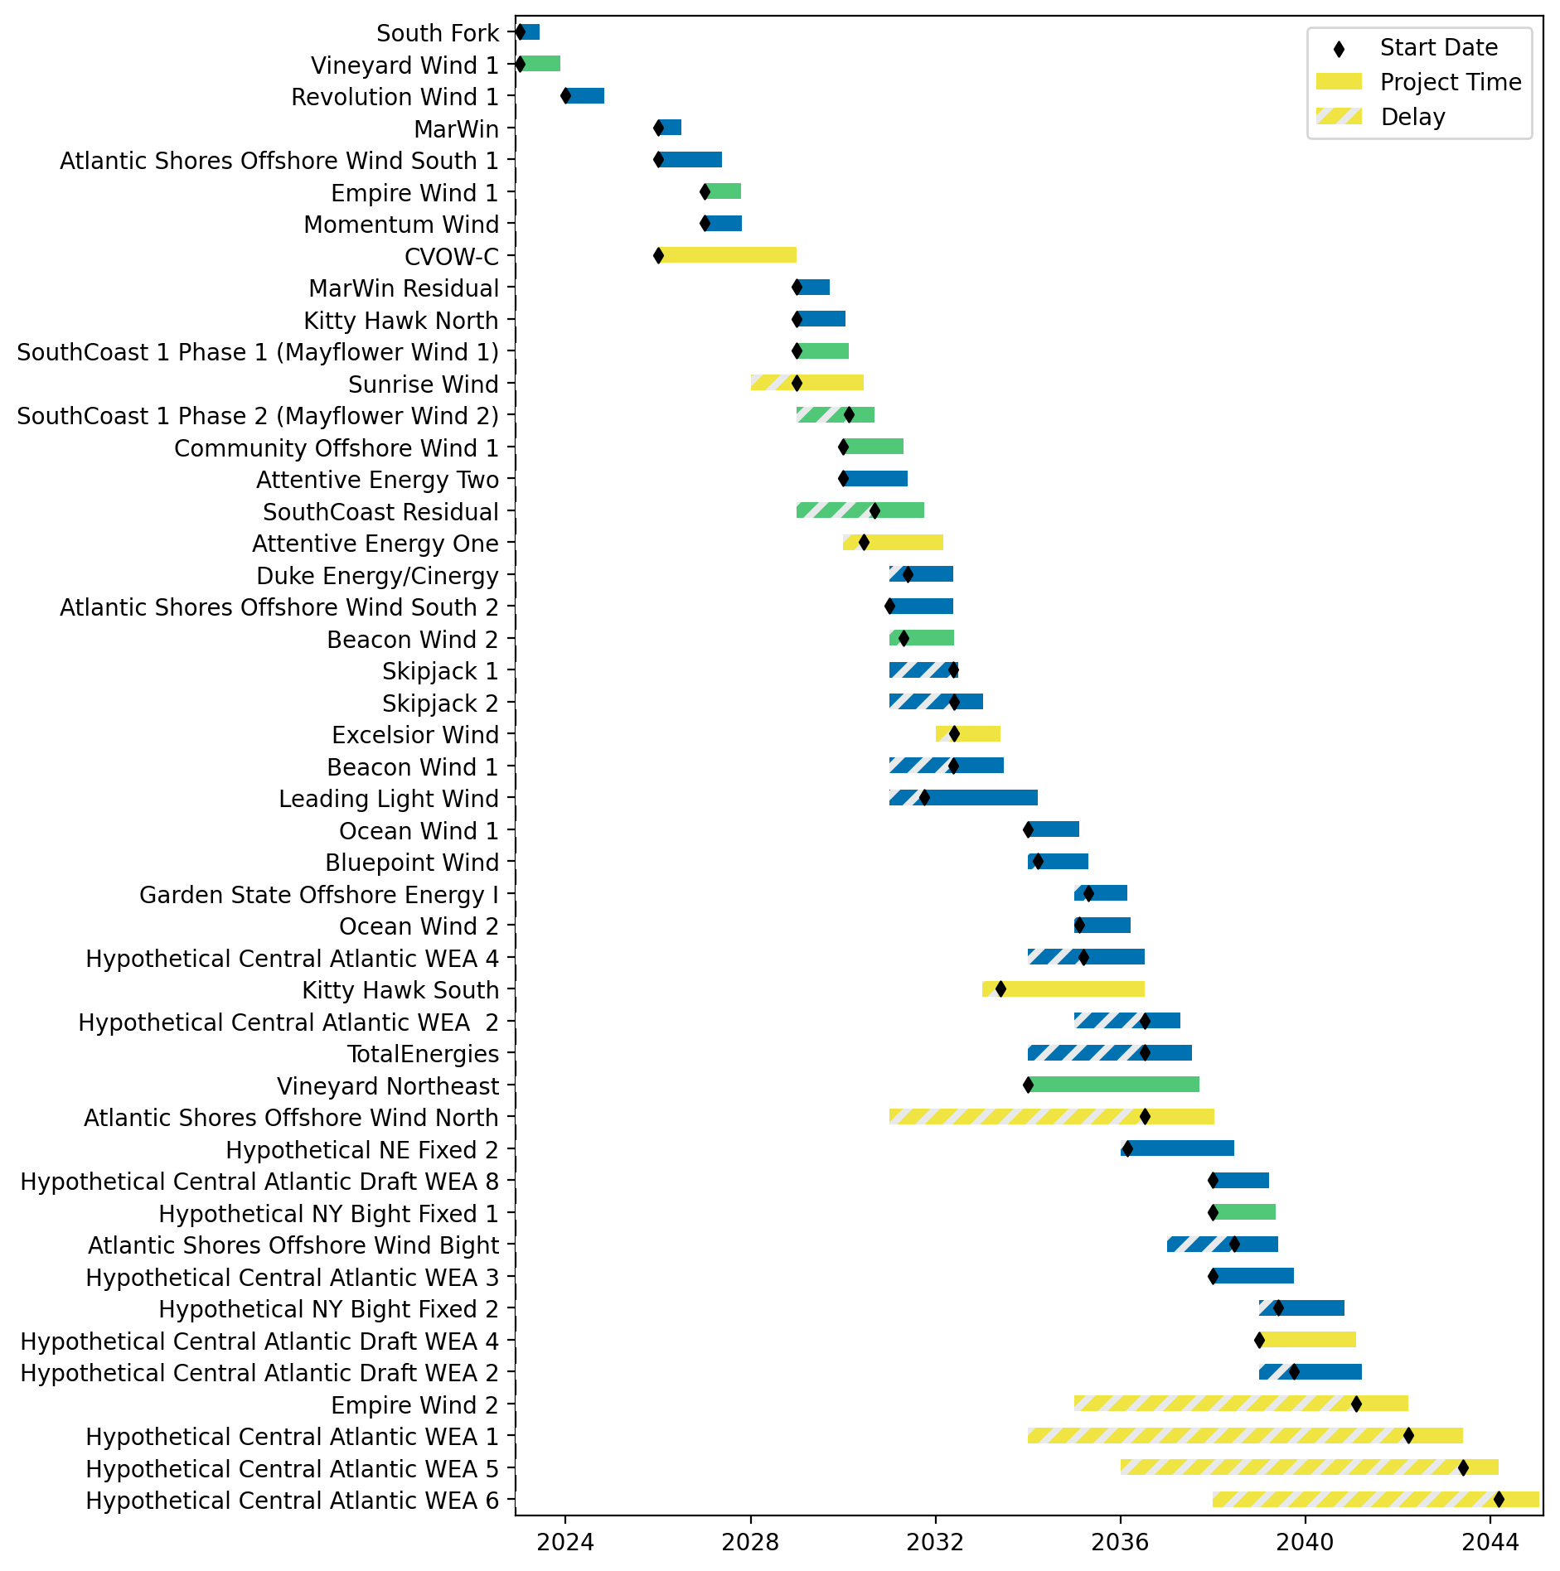
Fixed Gantt

Slide 28
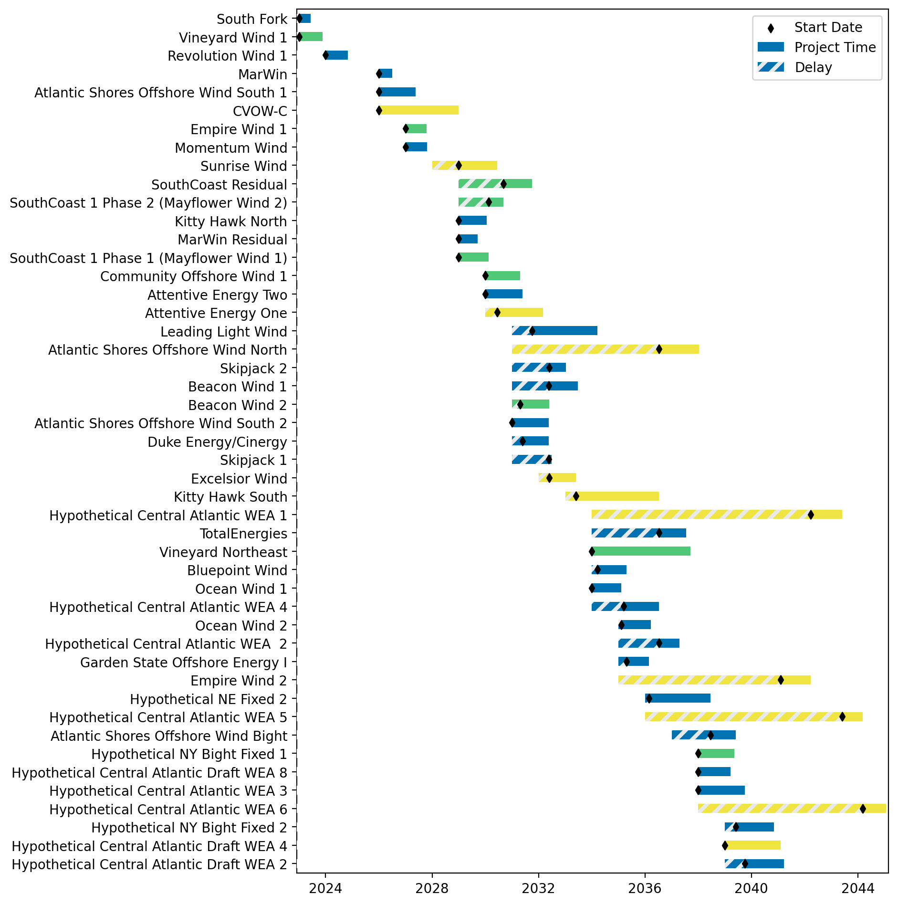
Sorted Fixed Gantt

Slide 29

Total Vessel Investments

Slide 30
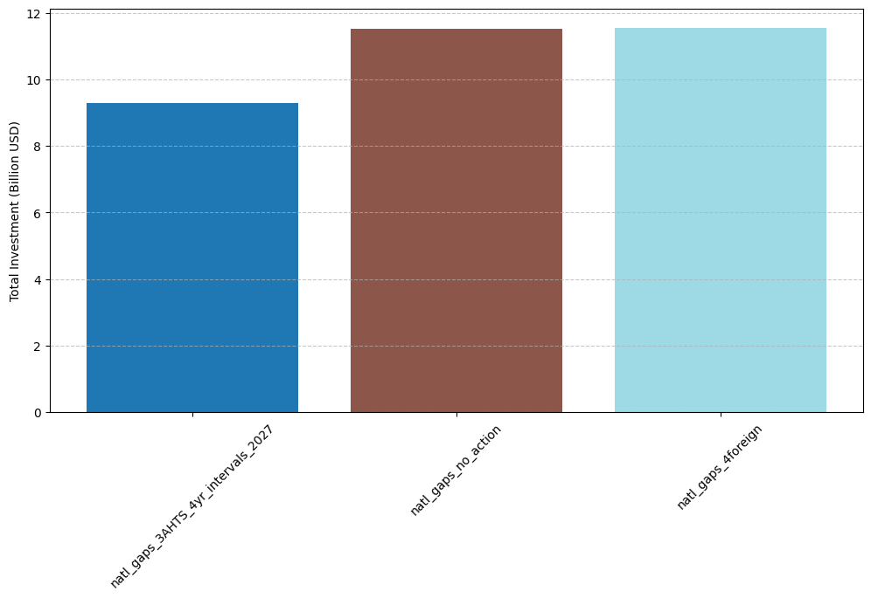
Total Vessel Investments by Scenario

Slide 31
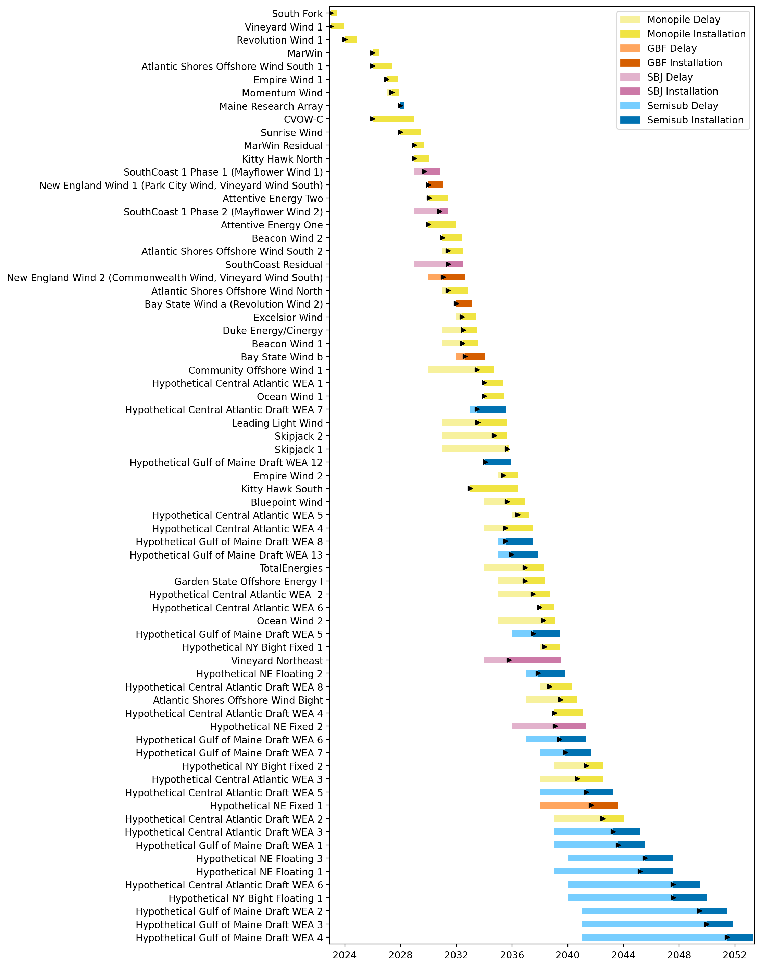
Full Gantt

Slide 32
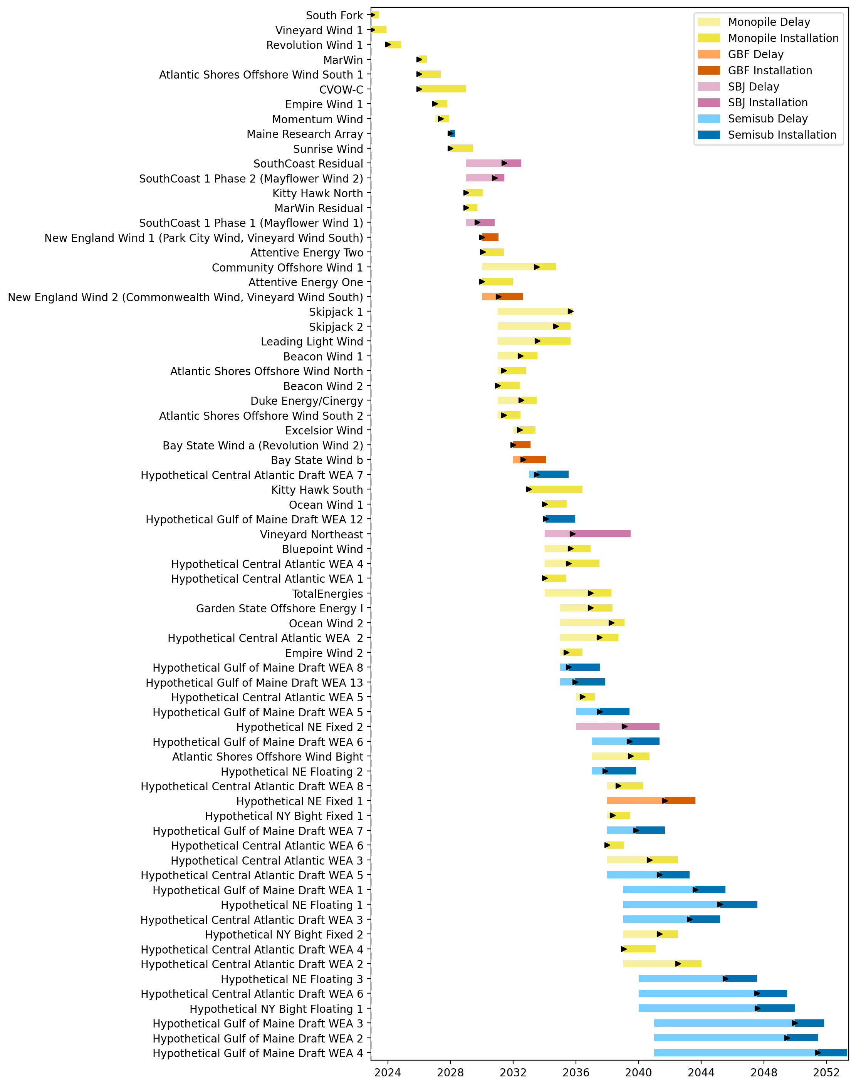
Sorted Full Gantt

Slide 33
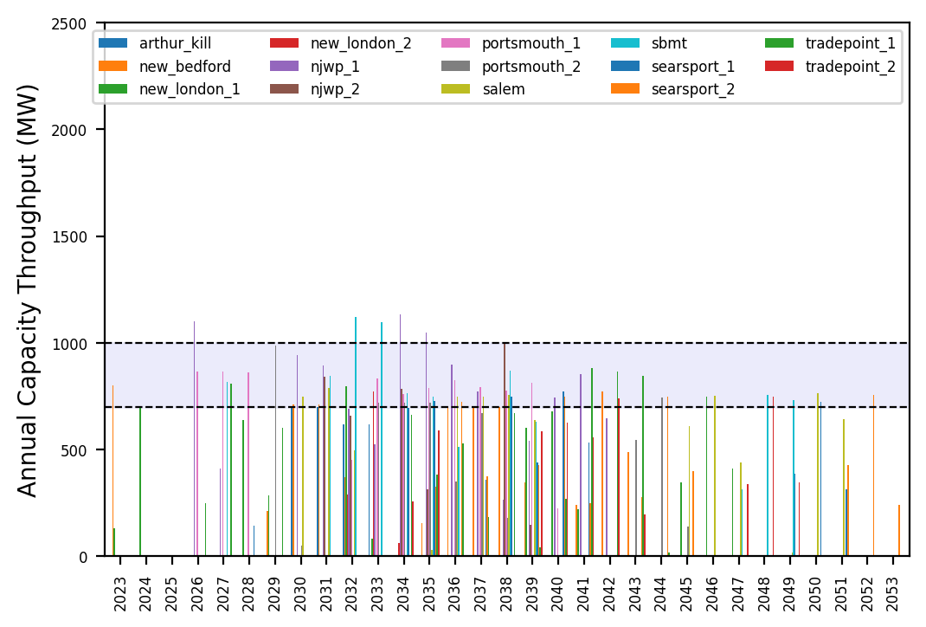
Port Throughput

Slide 34
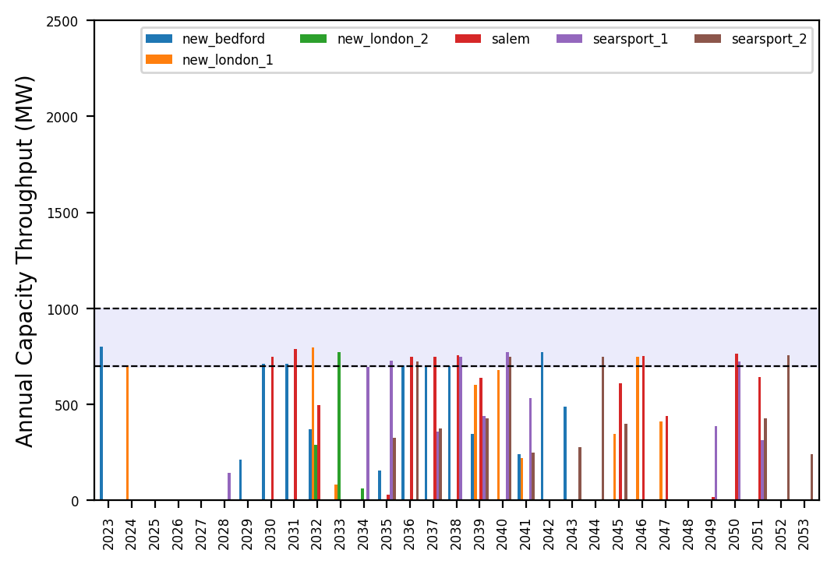
Port Throughput

Slide 35
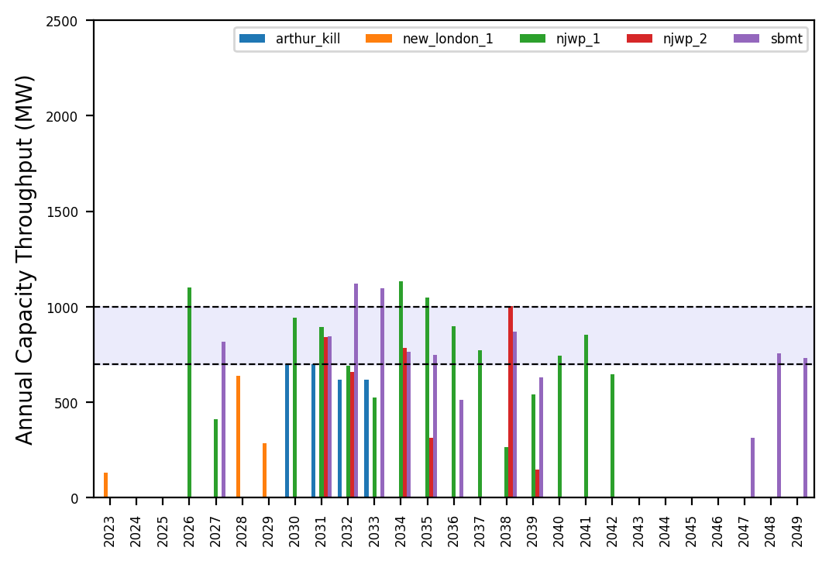
Port Throughput

Slide 36
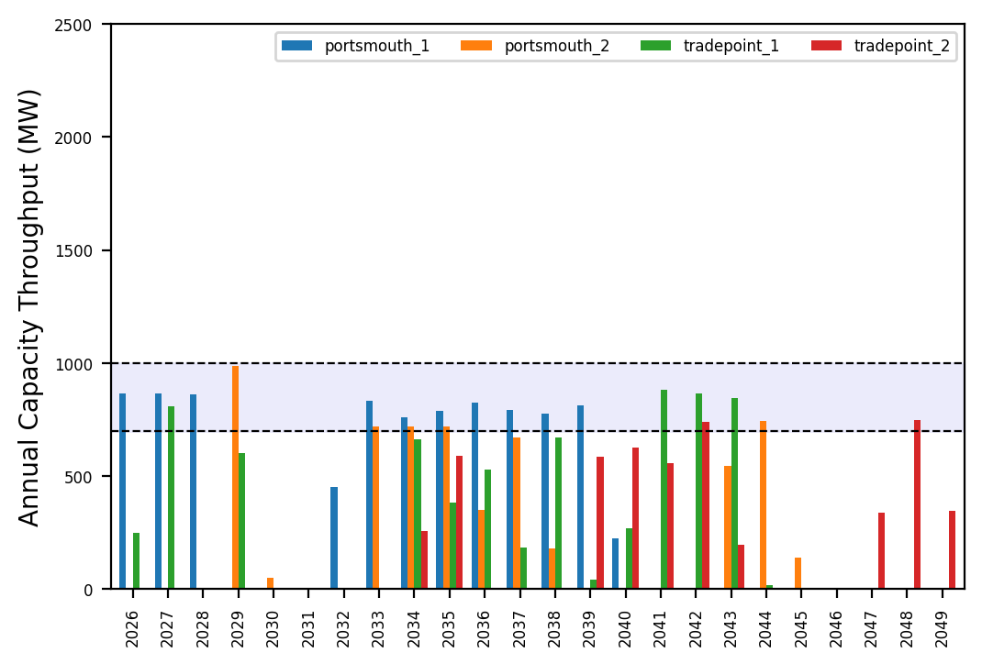
Port Throughput

Slide 37
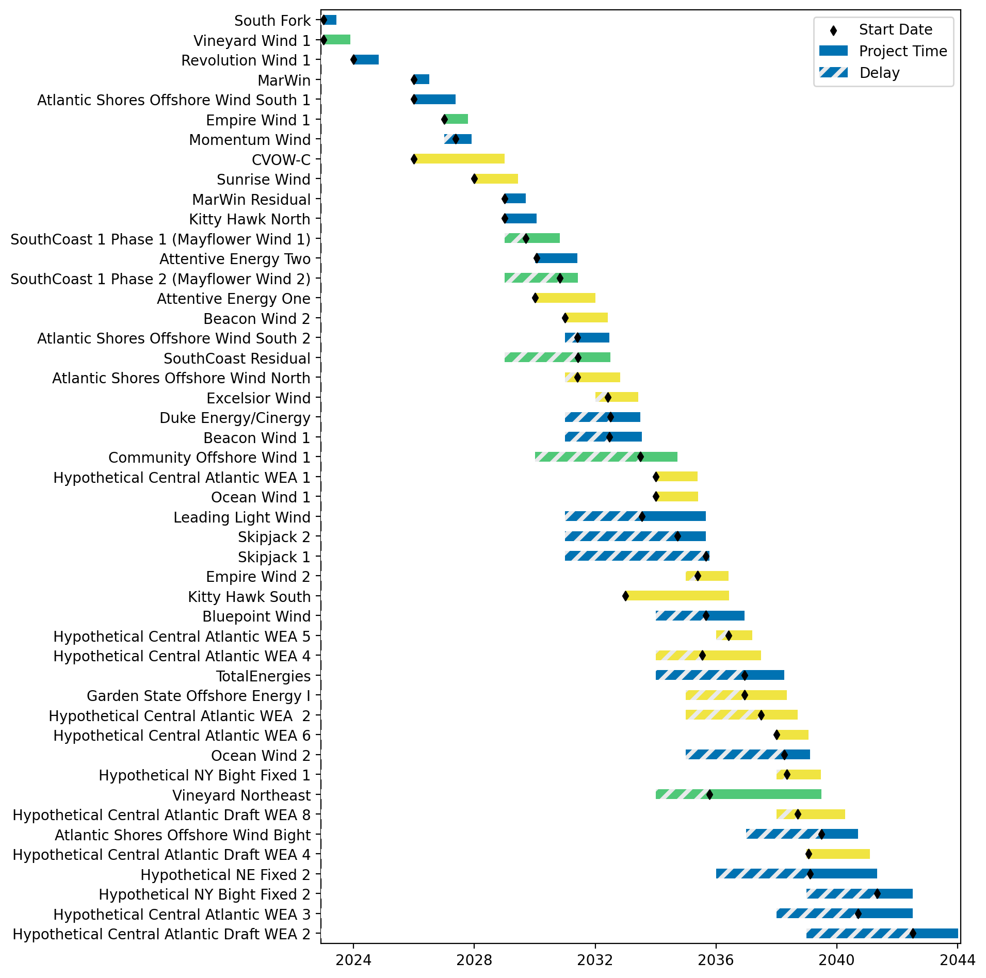
Fixed Gantt

Slide 38
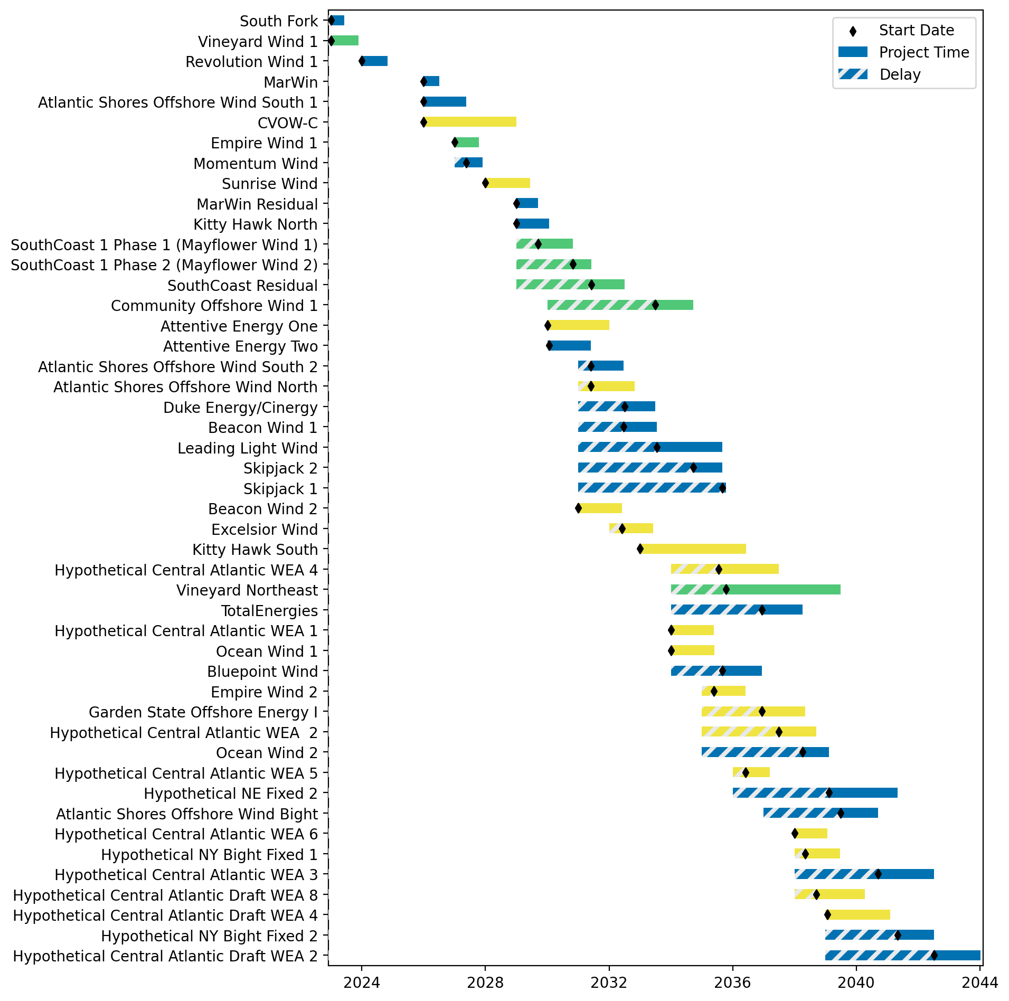
Sorted Fixed Gantt

Slide 39
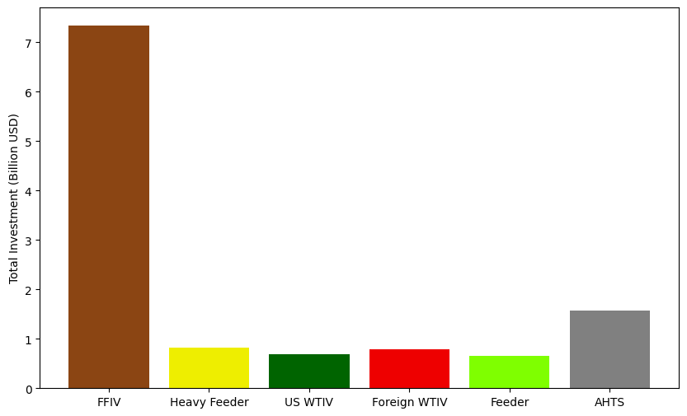
Total Vessel Investments

Slide 40
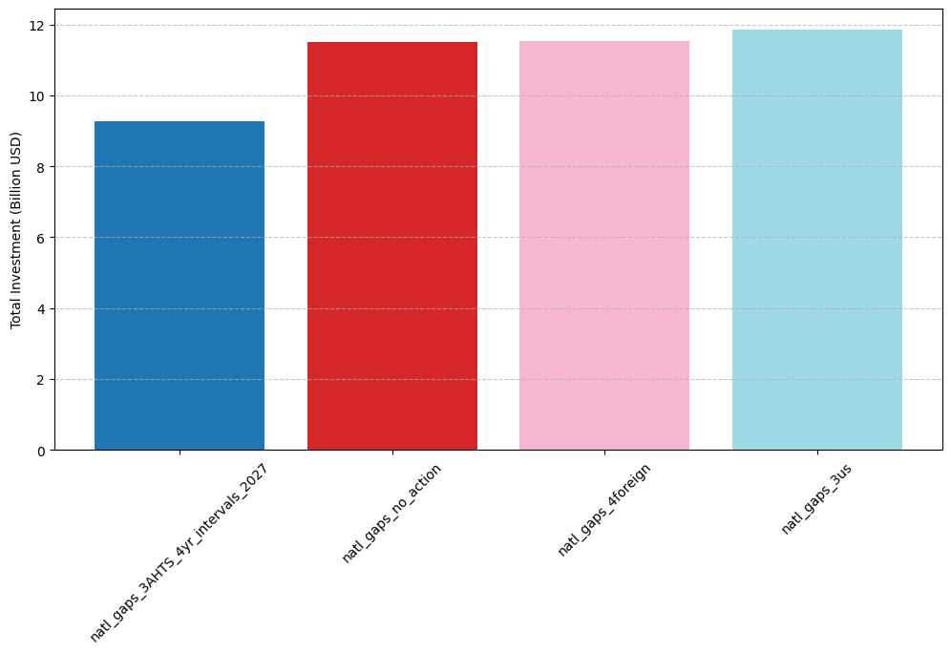
Total Vessel Investments by Scenario

Slide 41
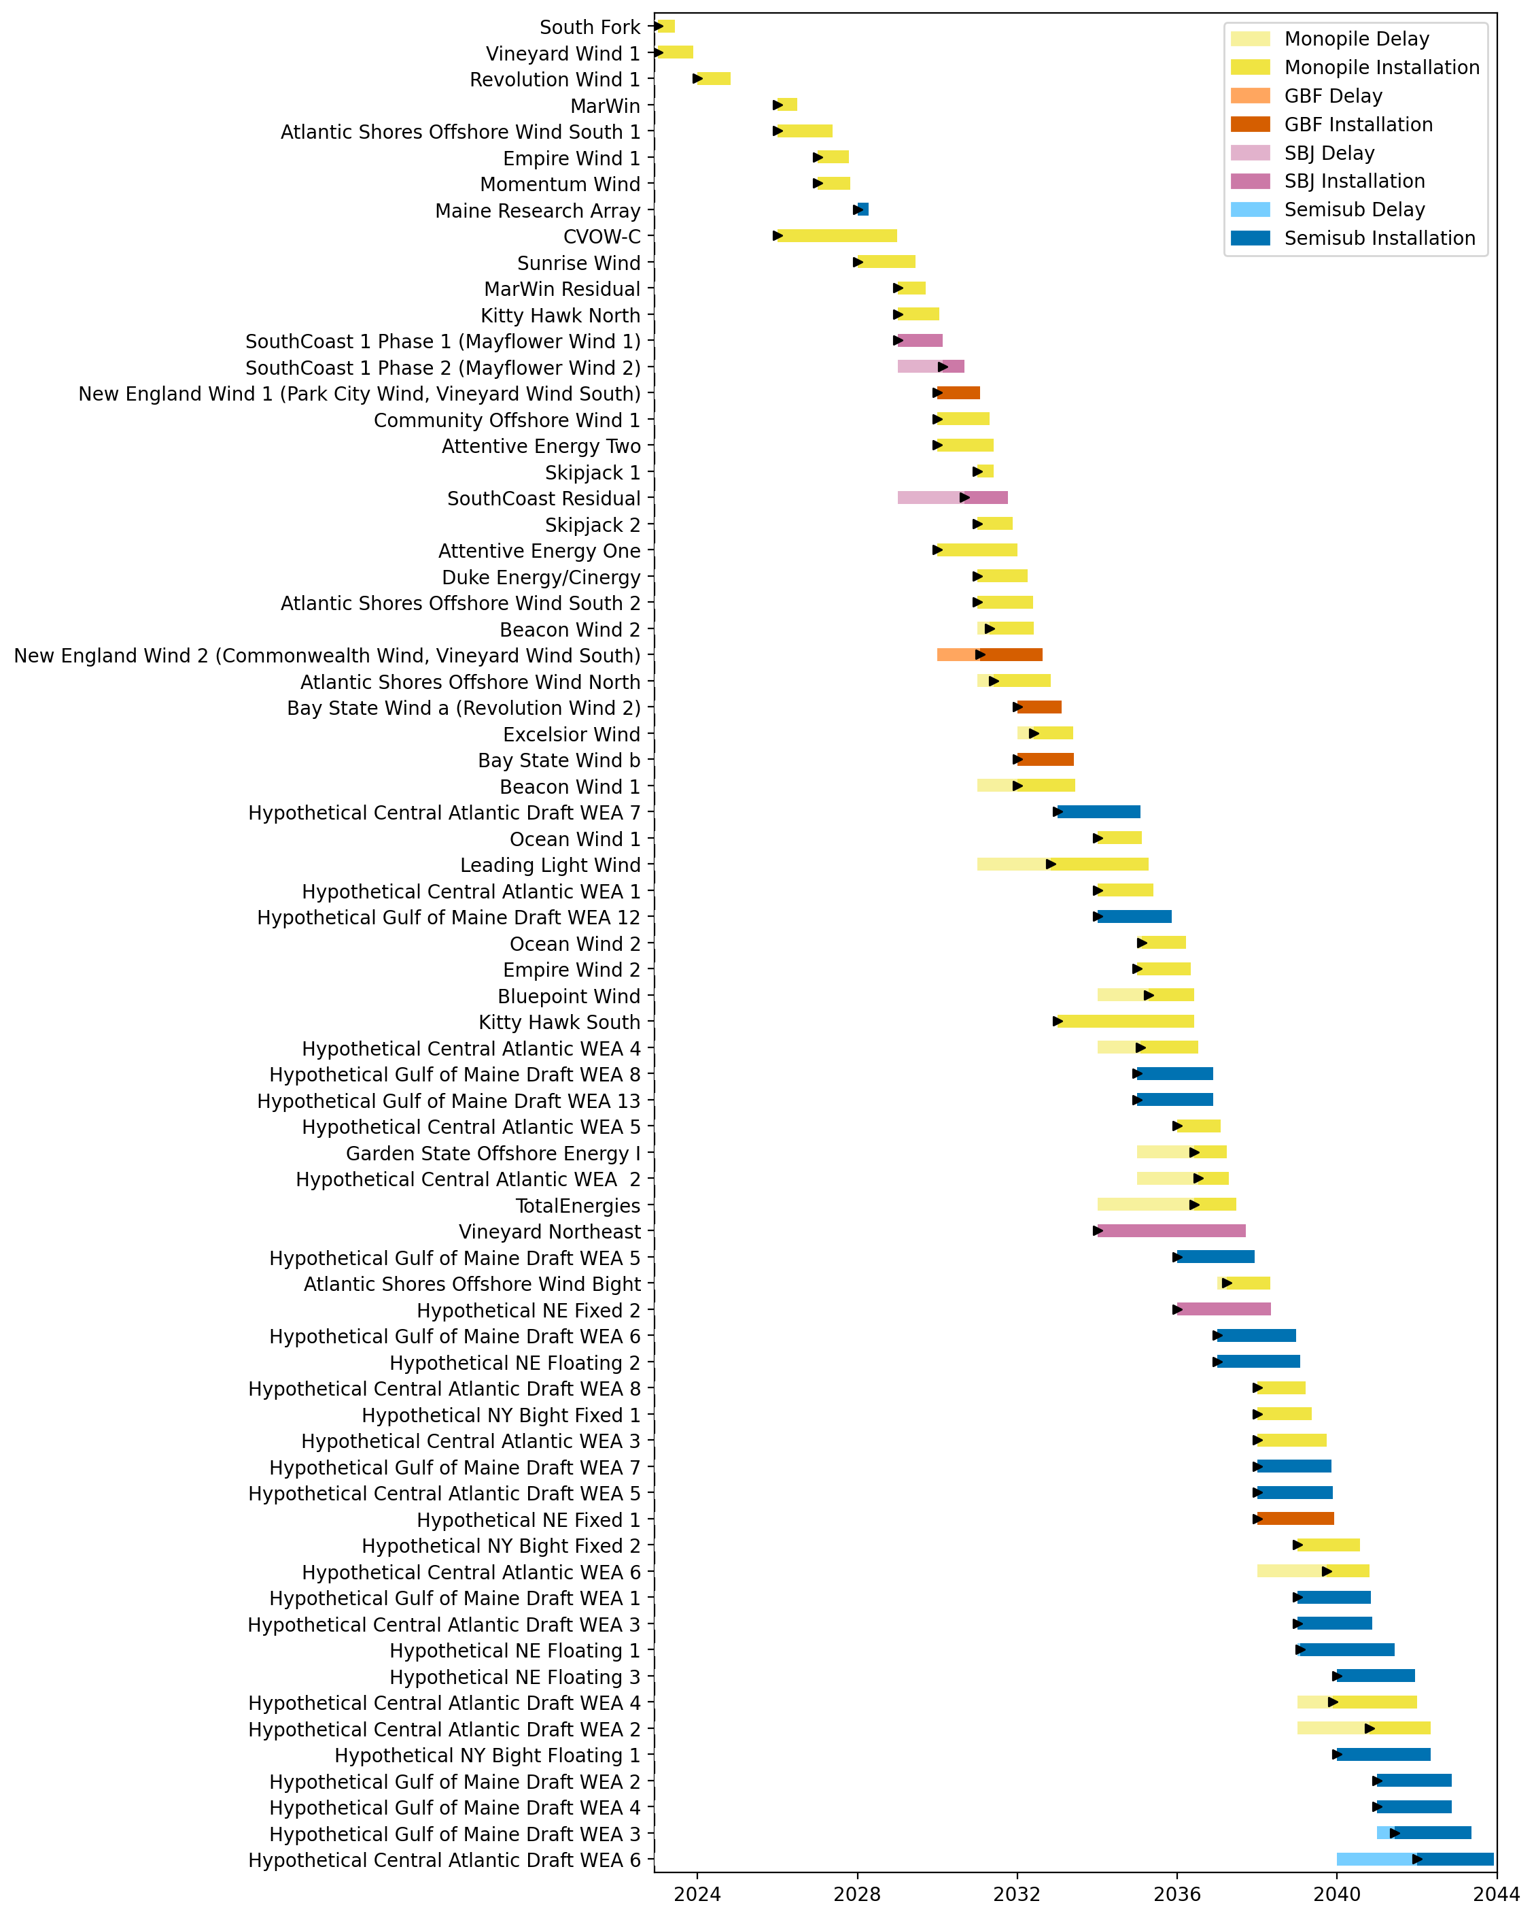
Full Gantt

Slide 42
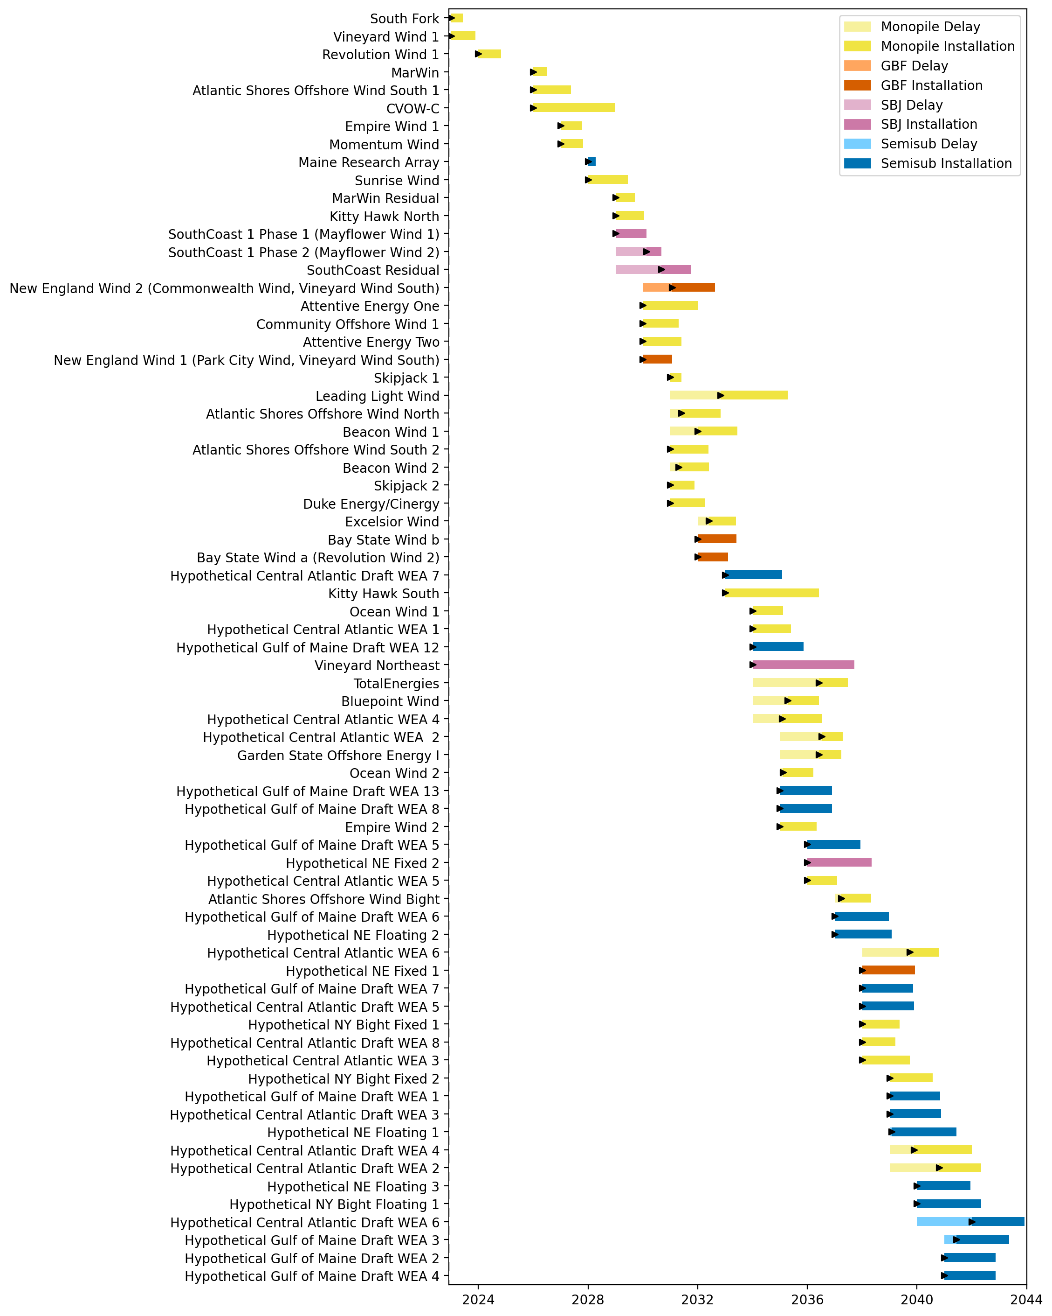
Sorted Full Gantt

Slide 43
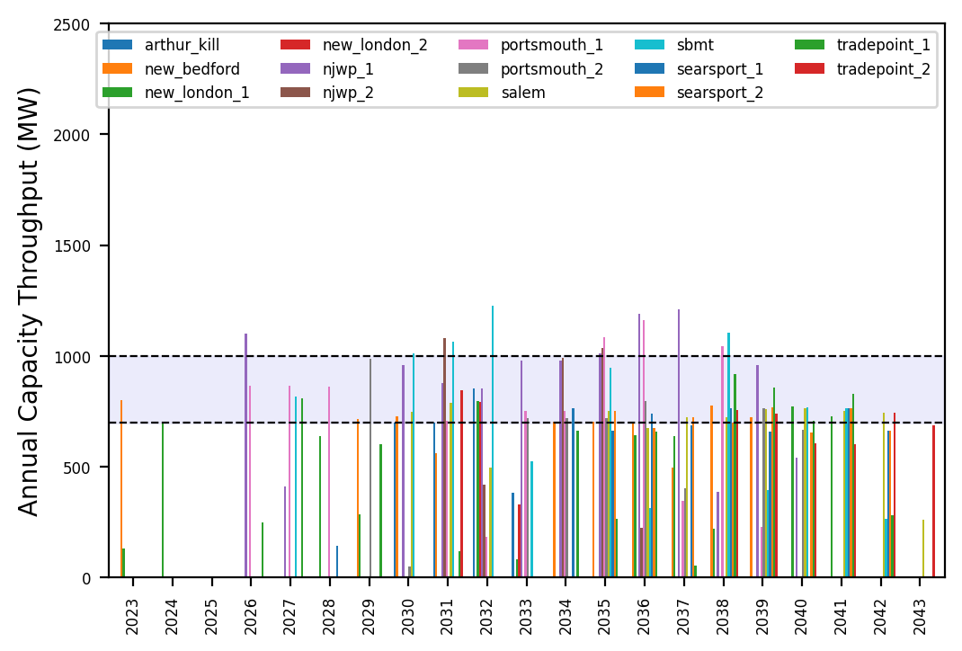
Port Throughput

Slide 44
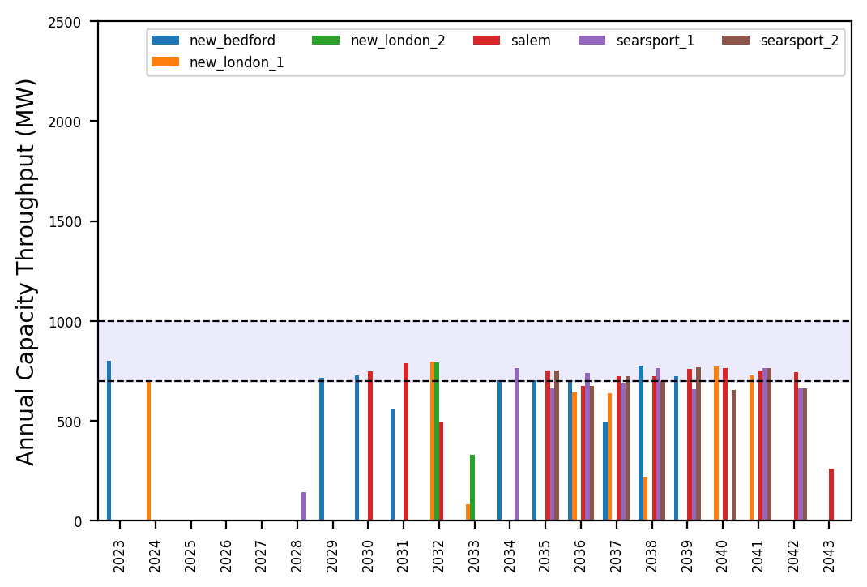
Port Throughput

Slide 45
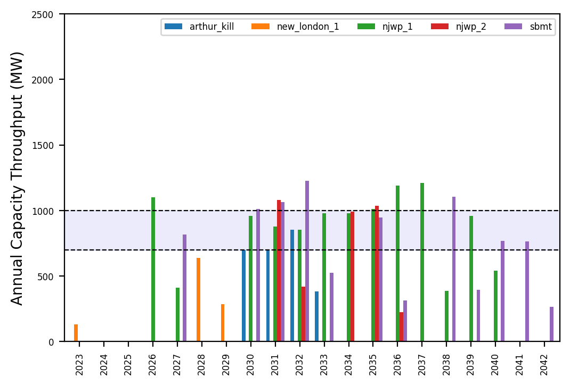
Port Throughput

Slide 46
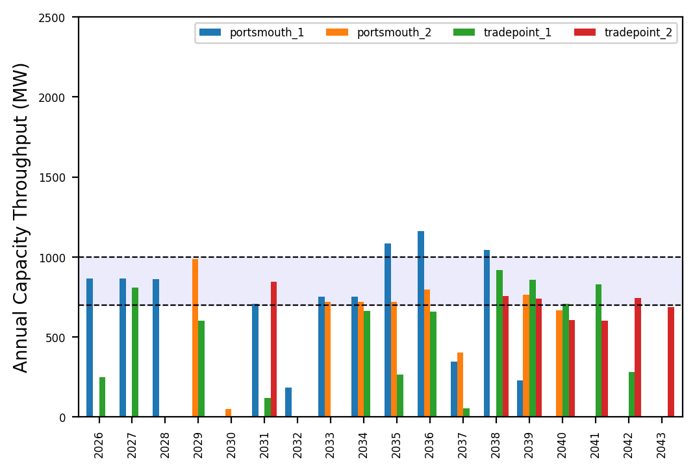
Port Throughput

Slide 47
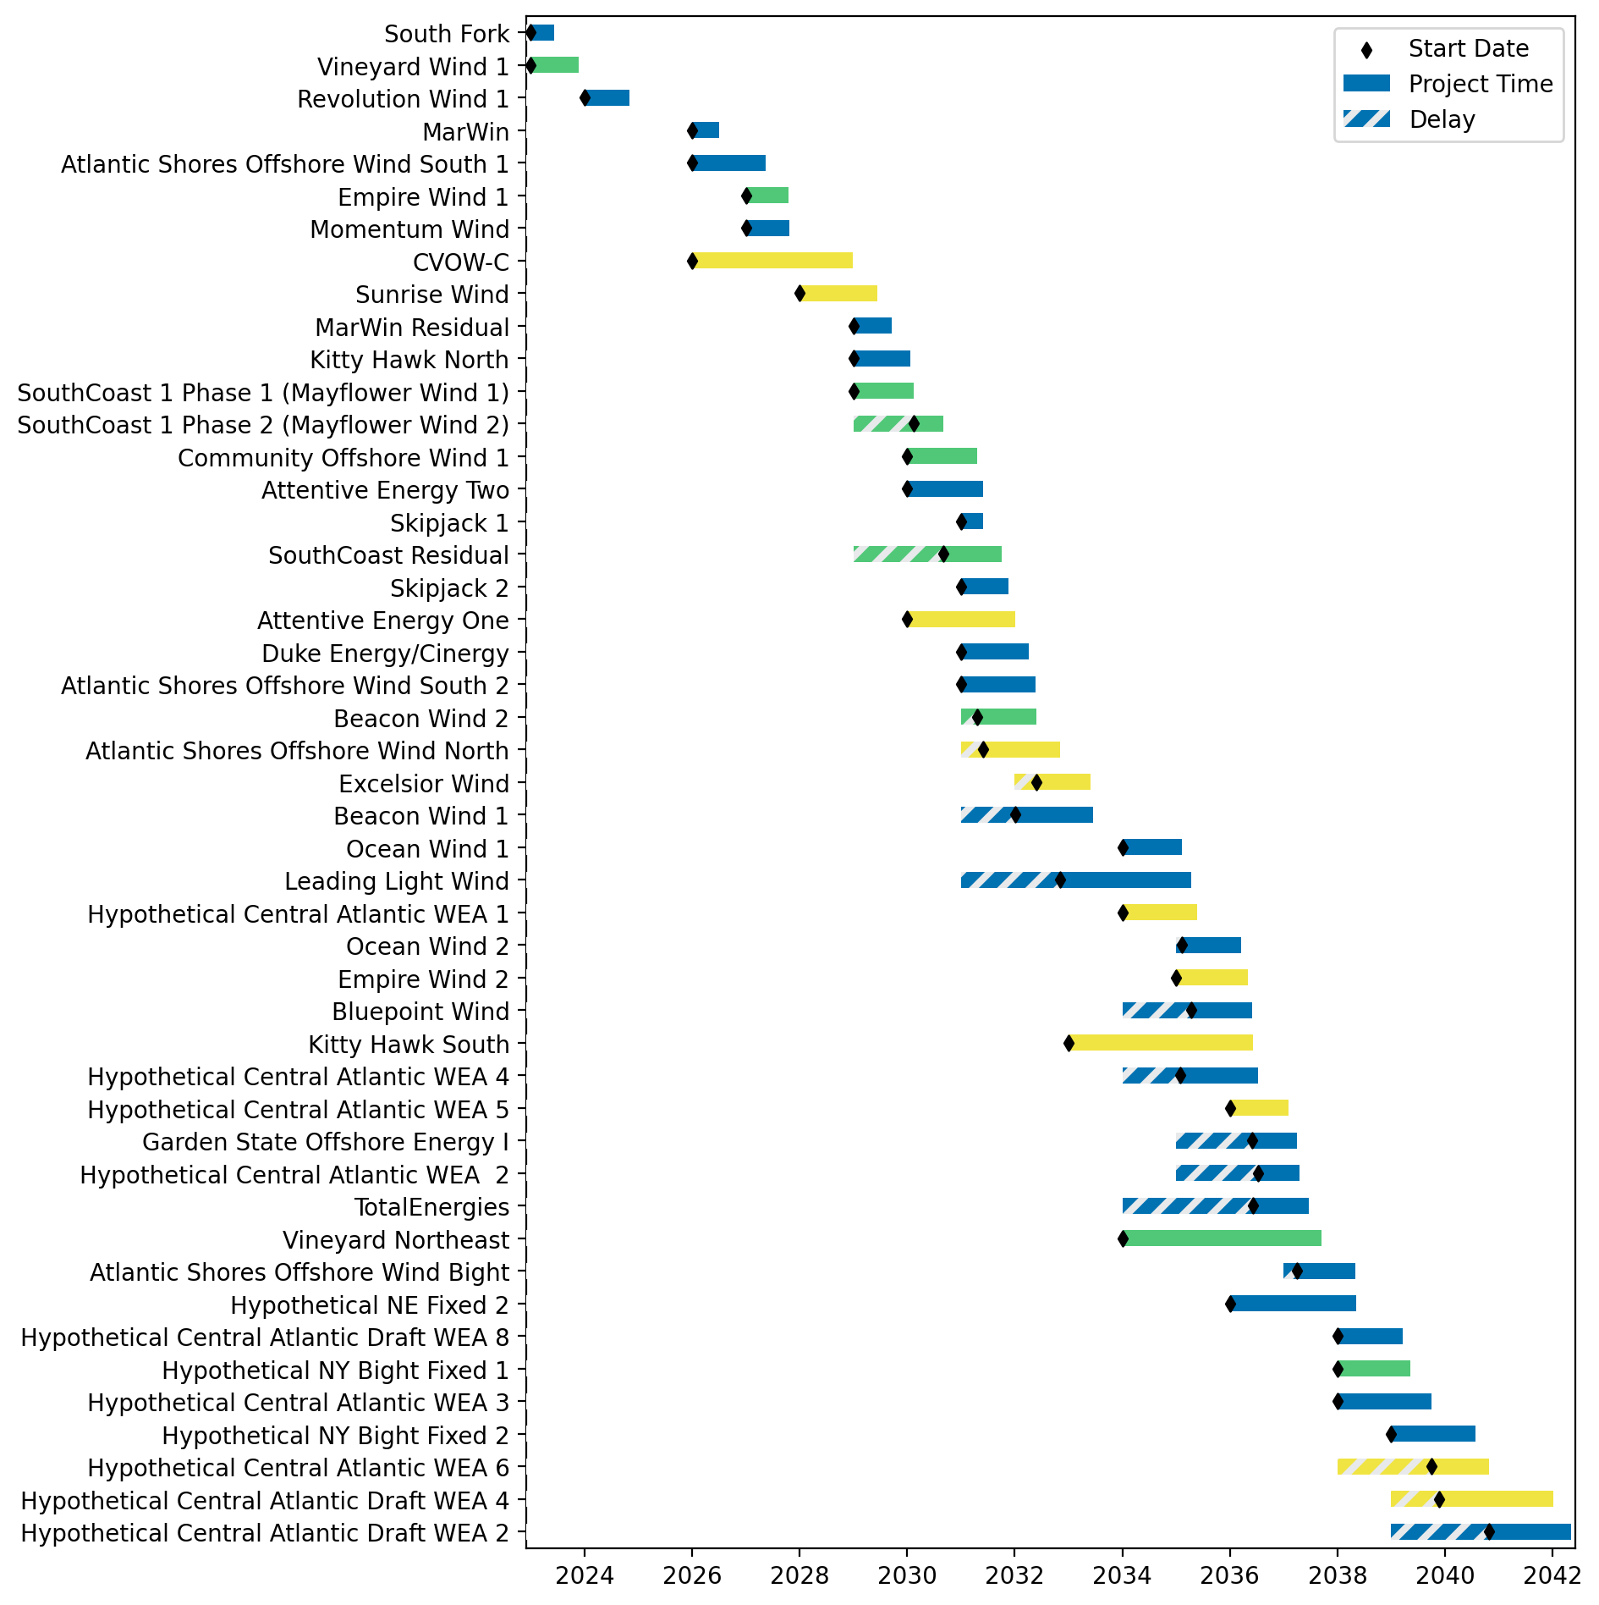
Fixed Gantt

Slide 48
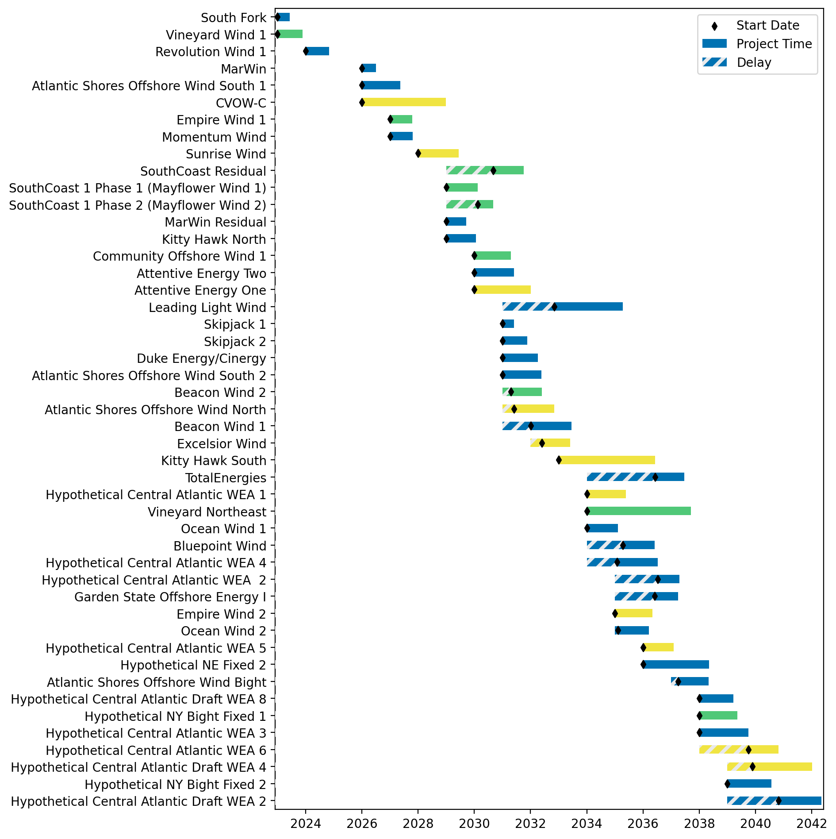
Sorted Fixed Gantt

Slide 49
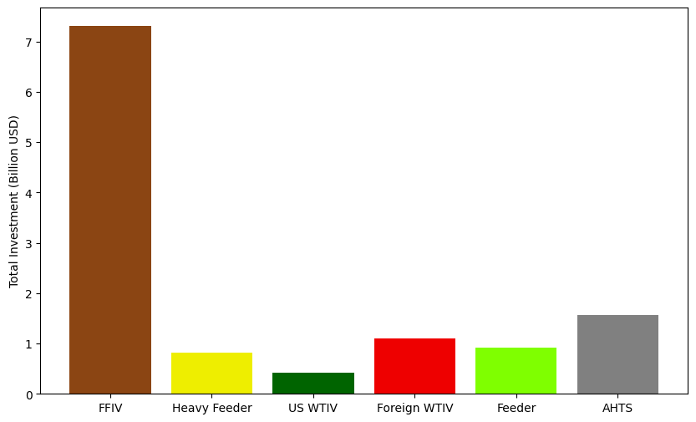
Total Vessel Investments

Slide 50
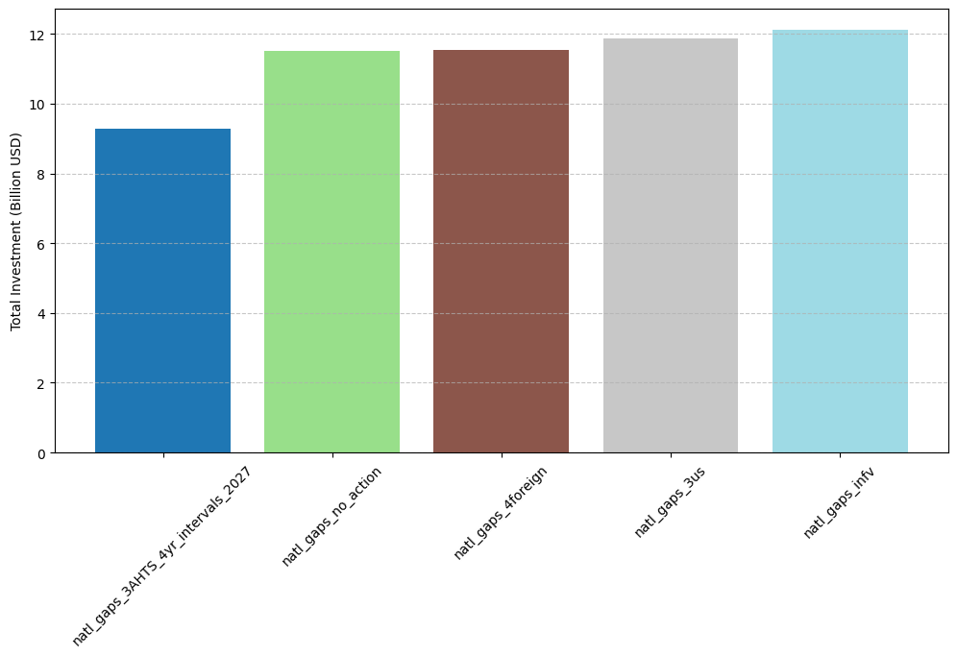
Total Vessel Investments by Scenario

